Slide 1
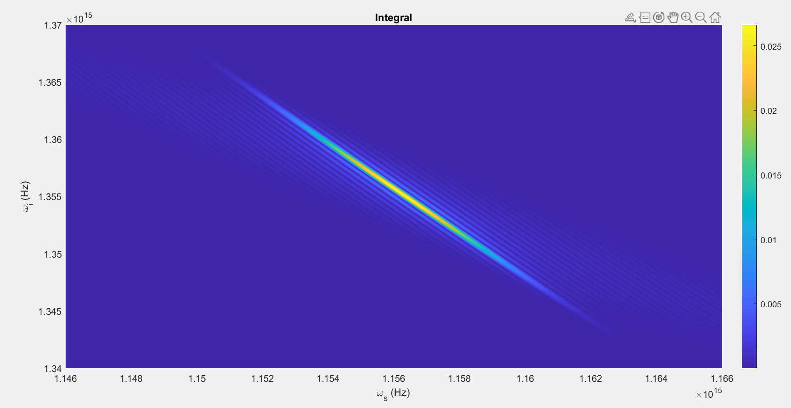
Using dummy function, alpha (Gaussian)

Slide 2
Parameters #1:
T = 80ps
N=2048
Beta_f2 = 0.0083 ps^2/cm
Beta_s2 = 0.0022 ps^2/cm
Beta_p2 = 0.0253 ps^2/cm
Beta_f1 = 5.633 ps/cm
Beta_s1 = 5.333 ps/cm
Kappa = 6900, 1/cm
Gamma = 10^1.5, 1/(cm sqrt(kW))
C = 1, 1/cm
A = 1kW
Pulsewidth = 10ps
U0 = Real

Slide 3
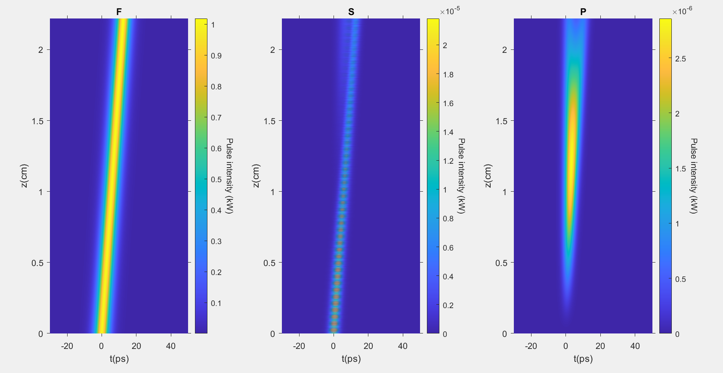

Slide 4
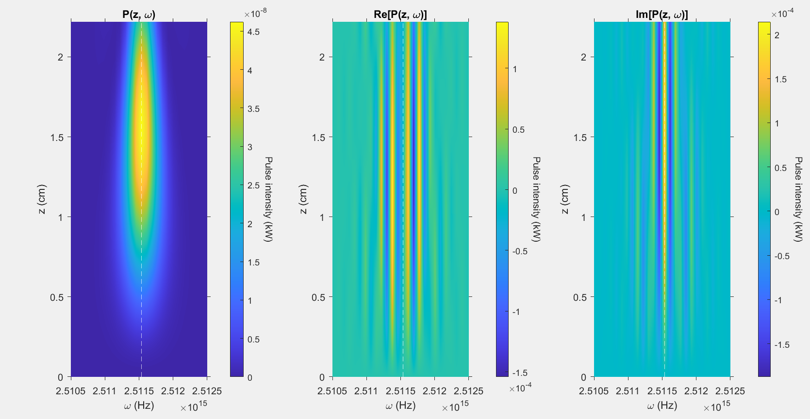

Slide 5
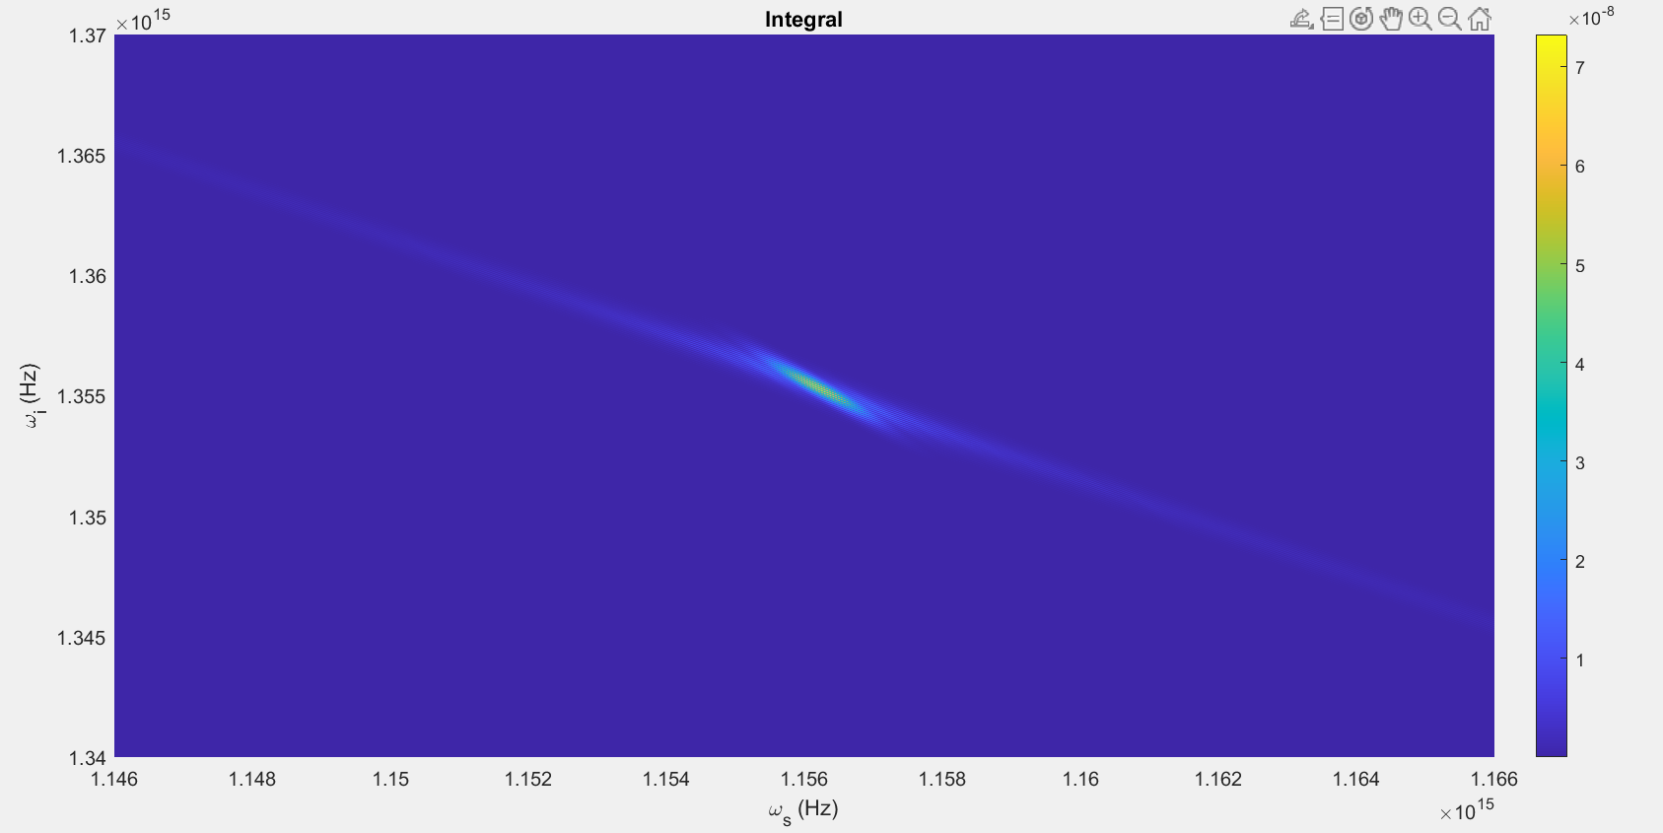

Slide 6
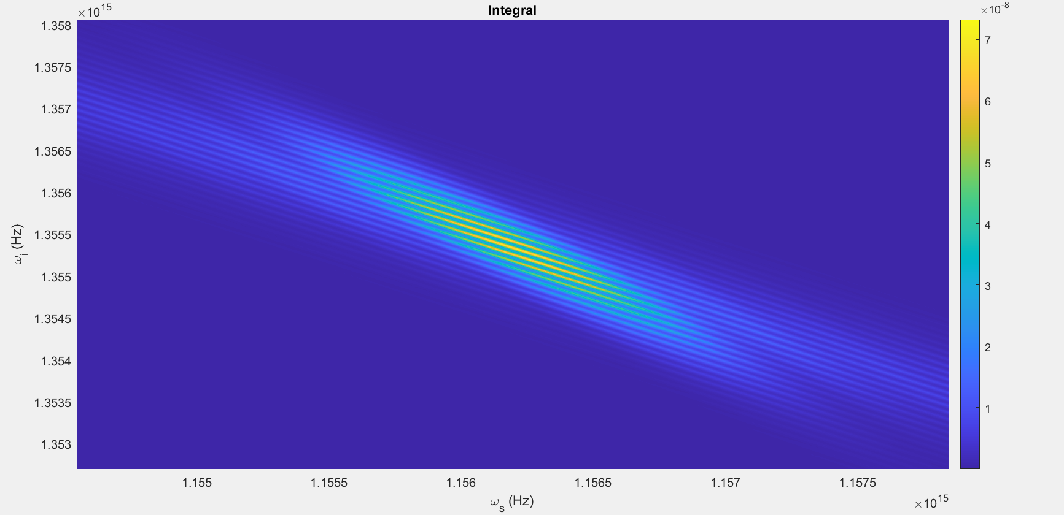

Slide 7
Parameters #2:
T = 80ps
N=2048
Beta_f2 = 0.0083 ps^2/cm
Beta_s2 = 0.0022 ps^2/cm
Beta_p2 = 0.0253 ps^2/cm
Beta_f1 = 5.633 ps/cm
Beta_s1 = 5.333 ps/cm
Kappa = 6900, 1/cm
Gamma = 10^1.5, 1/(cm sqrt(kW))
C = 1, 1/cm
A = 1kW
Pulsewidth = 10ps
U0 = Complex

Slide 8
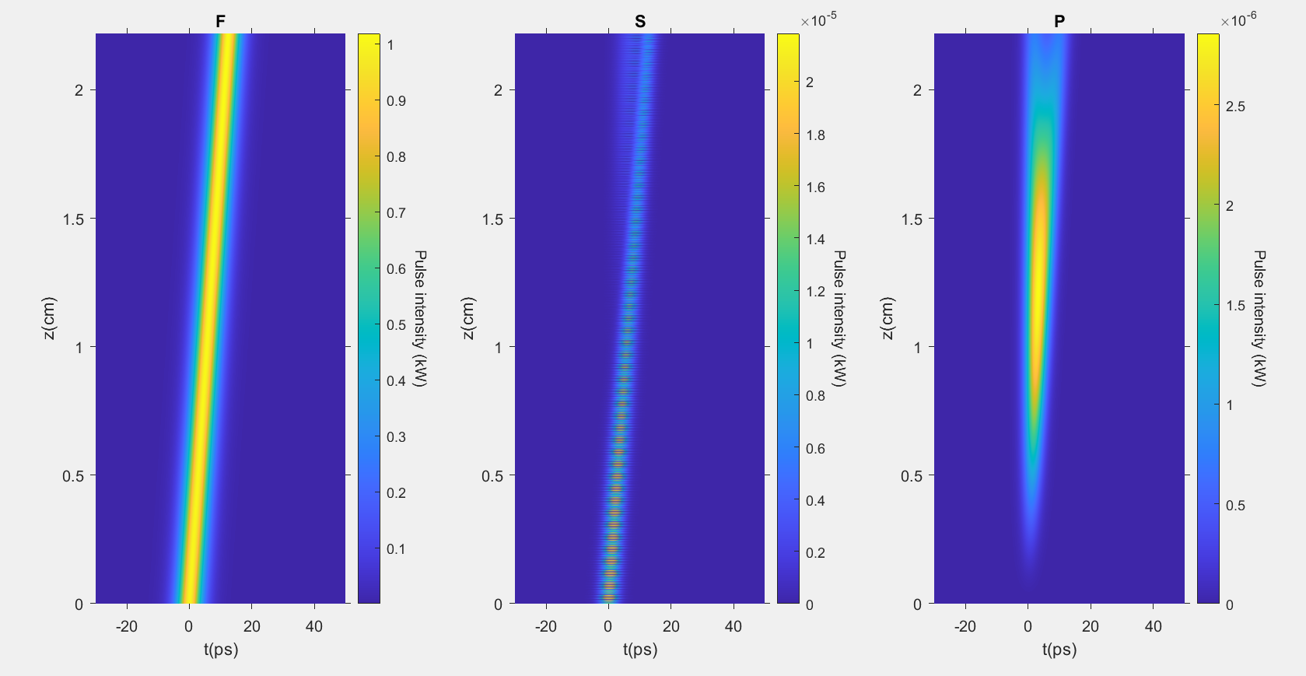

Slide 9
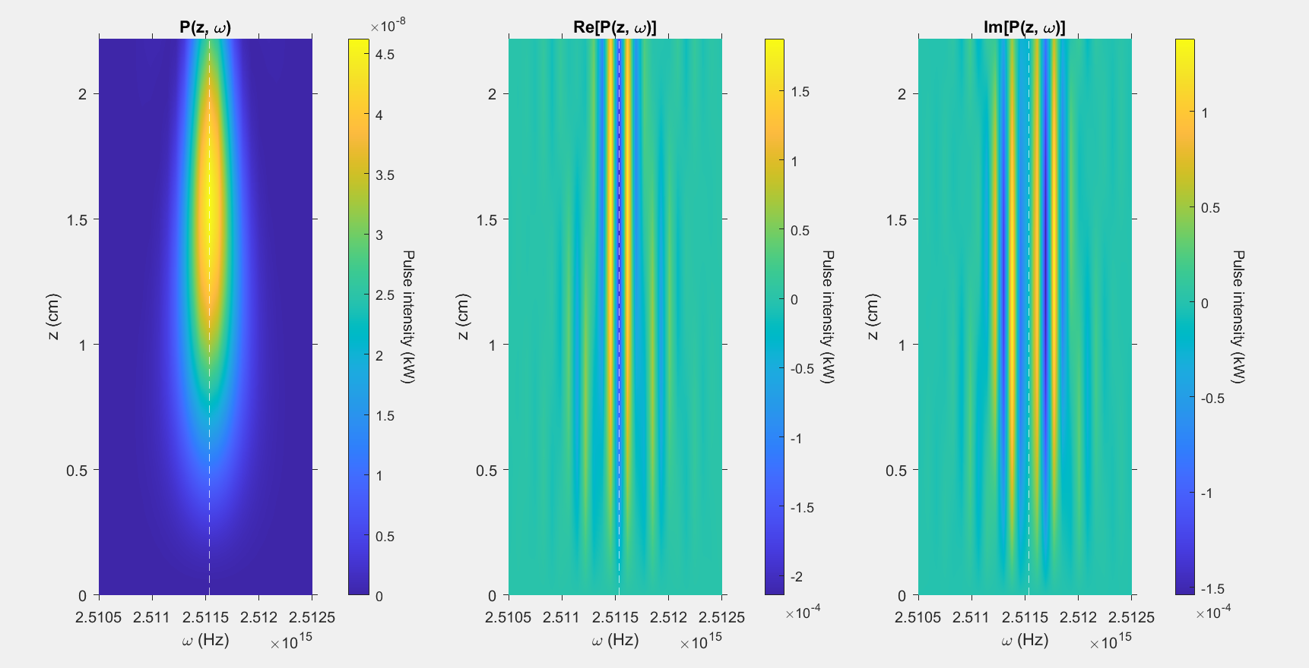

Slide 10
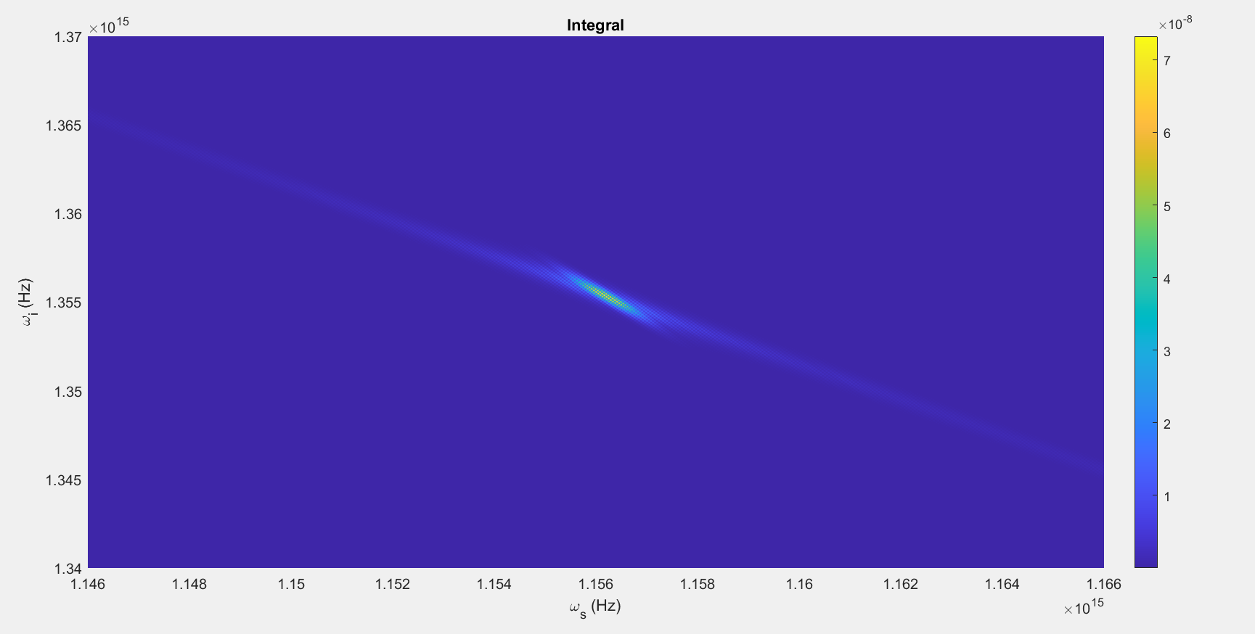

Slide 11
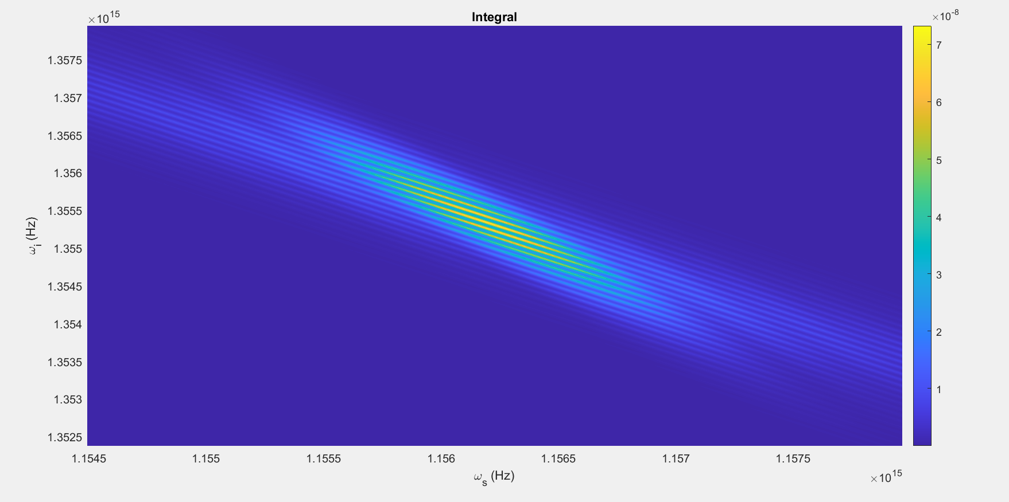

Slide 12
Changes
Clear change in fine structure of P(z, omega)
No/Unnoticeable change the final integral plot

Slide 13
Parameters #3:
T = 80ps
N=2048
Beta_f2 = 0.0083 ps^2/cm
Beta_s2 = 0.0022 ps^2/cm
Beta_p2 = 0.0253 ps^2/cm
Beta_f1 = 5.633 ps/cm
Beta_s1 = 5.333 ps/cm
Kappa = 6900, 1/cm
Gamma = 10^1.5, 1/(cm sqrt(kW))
C = 2, 1/cm, Zmax halved to compensate
A = 1kW
Pulsewidth = 10ps
U0 = Real

Slide 14
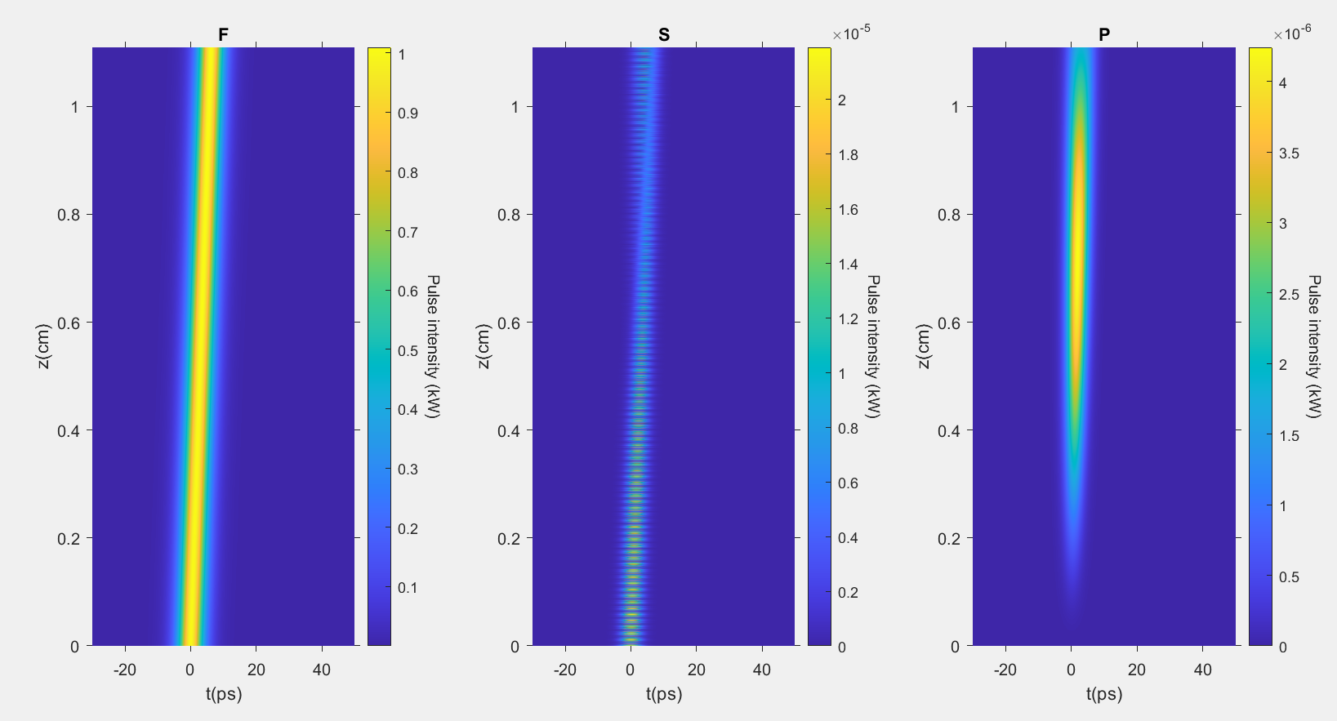

Slide 15
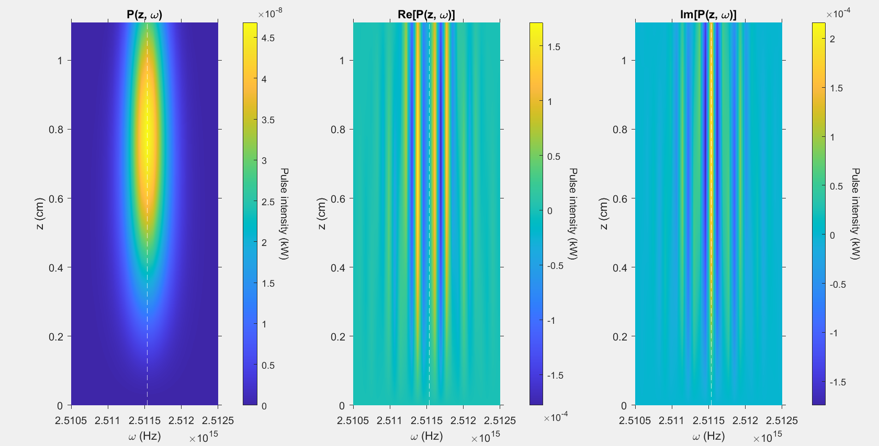

Slide 16
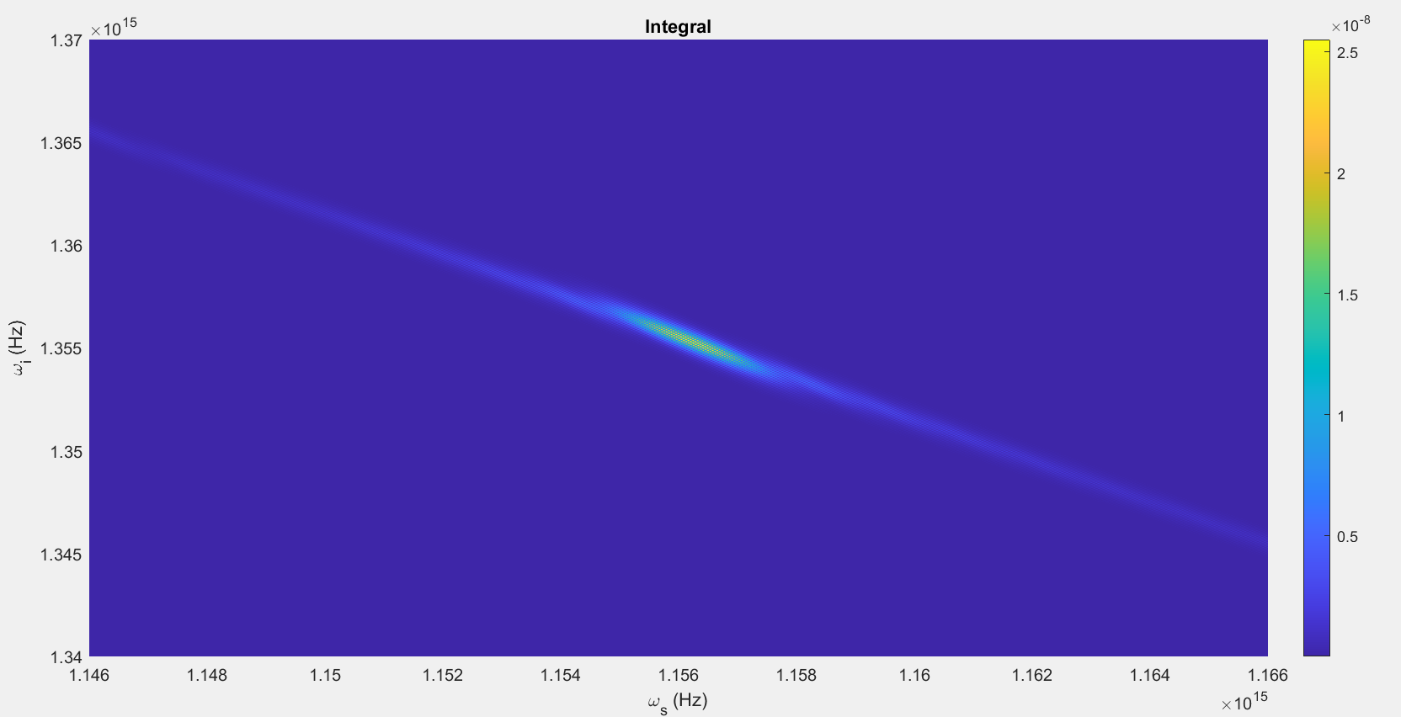

Slide 17
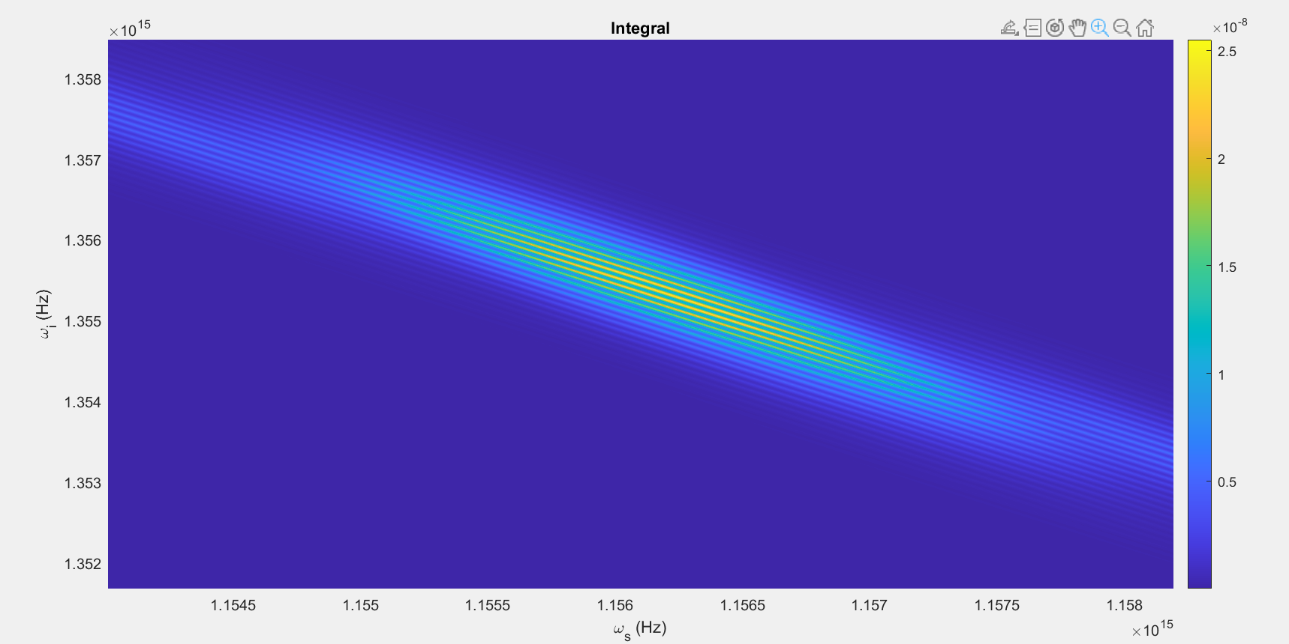

Slide 18
Changes
Pulse in final integral plot not at a weird angle compared to shadow

Slide 19
Parameters #4:
T = 80ps
N=2048
Beta_f2 = 0.0083 ps^2/cm
Beta_s2 = 0.0022 ps^2/cm
Beta_p2 = 0.0253 ps^2/cm
Beta_f1 = 5.633 ps/cm
Beta_s1 = 5.333 ps/cm
Kappa = 6900, 1/cm
Gamma = 10^1.5, 1/(cm sqrt(kW))
C = 0.5, 1/cm,Zmax doubled to compensate
A = 1kW
Pulsewidth = 10ps
U0 = Real

Slide 20
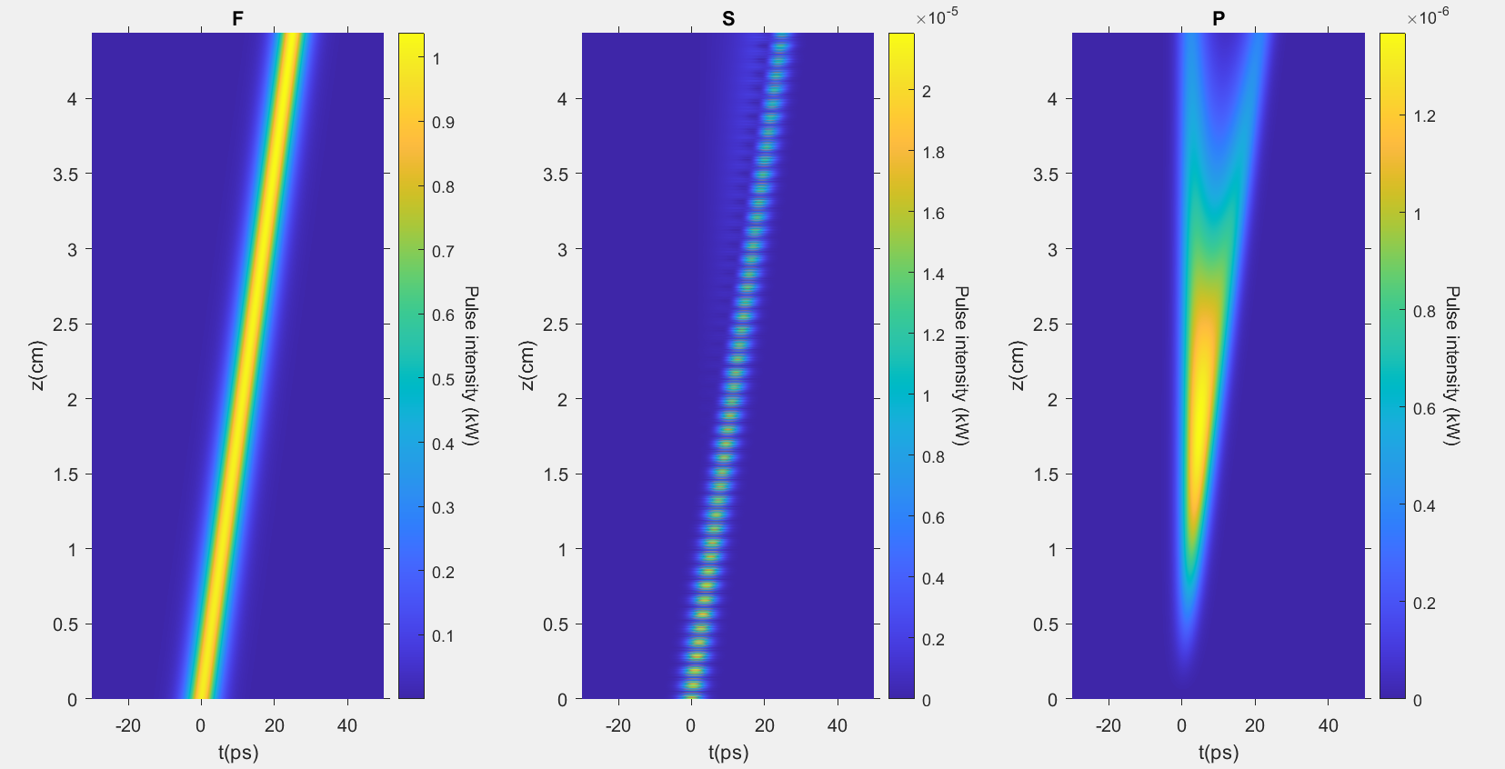

Slide 21
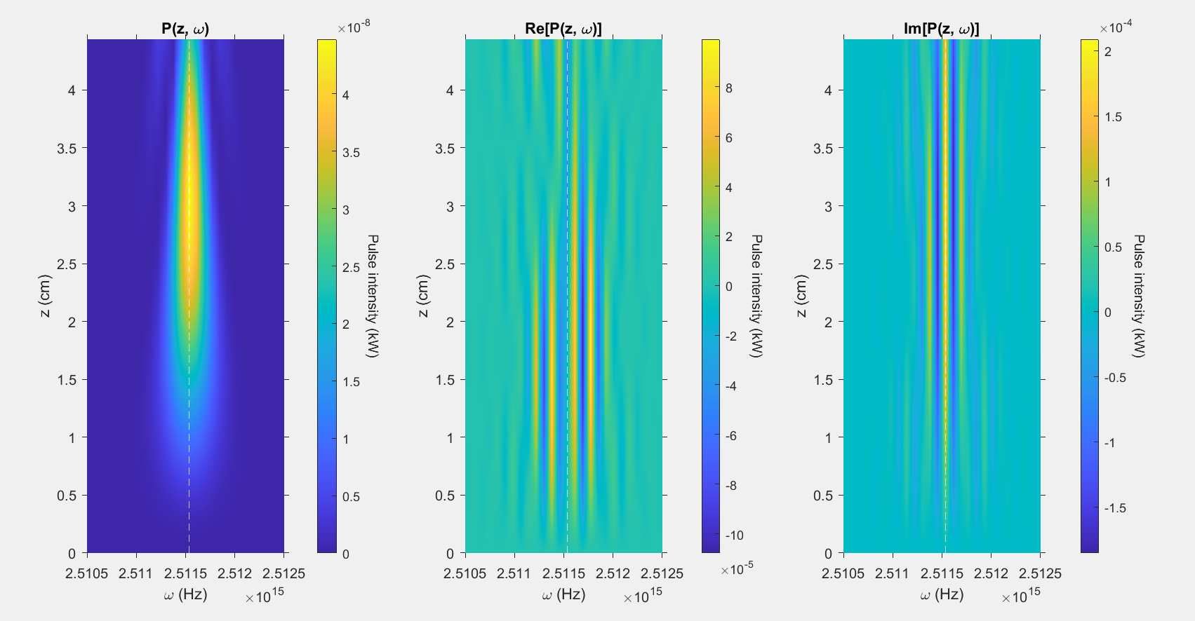

Slide 22
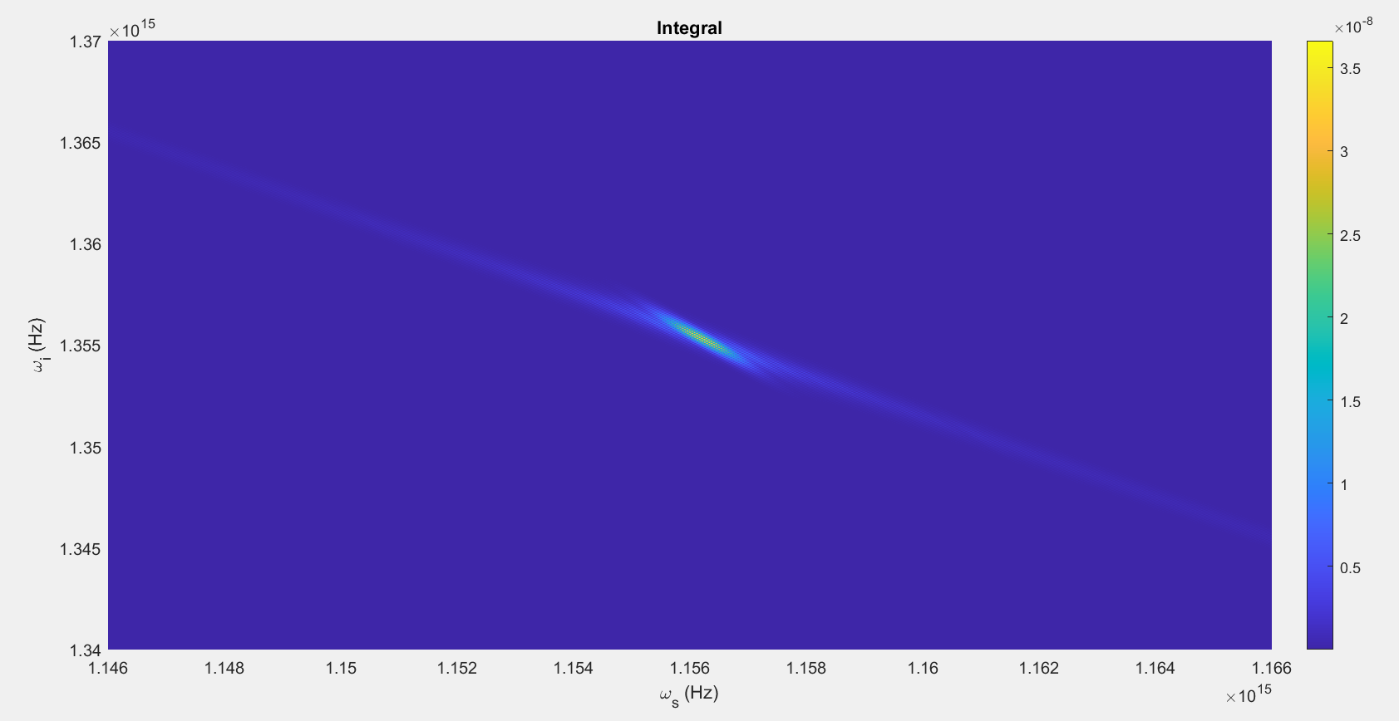

Slide 23
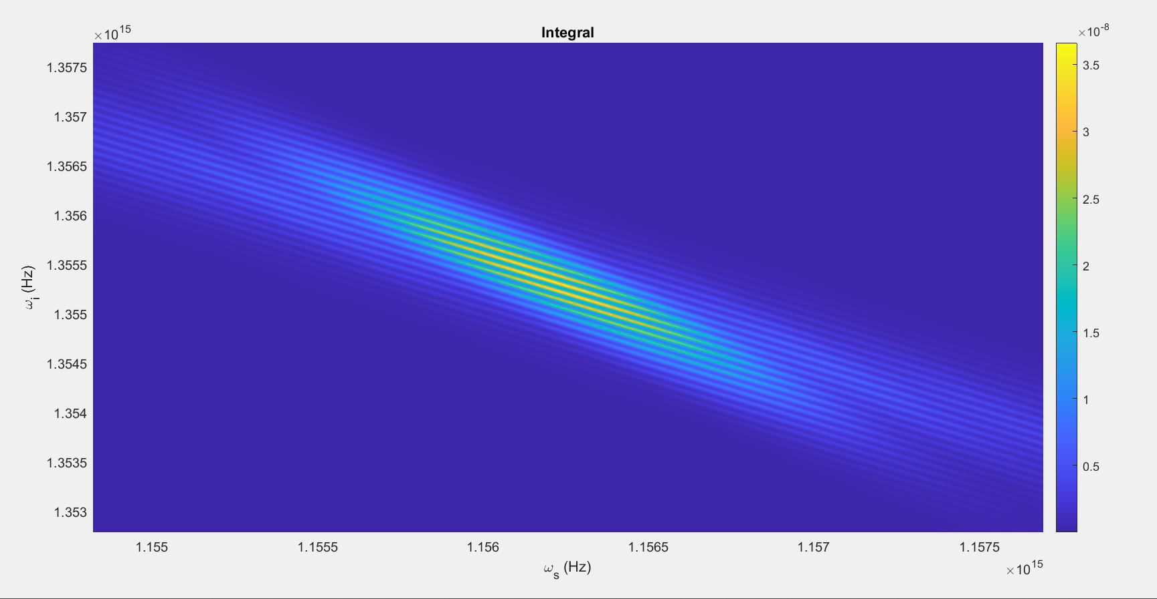

Slide 24
Changes
Peak of P(z,t), and therefore P(z, omega), at end of waveguide
No/Unnoticeable changes in final integral plot
Angle difference in final plot seems to depend on if the pulse splitting in P(z,t) is visible or not

Slide 25
Parameters #5:
T = 80ps
N=2048
Beta_f2 = 0.0083 ps^2/cm
Beta_s2 = 0.0022 ps^2/cm
Beta_p2 = 0.0253 ps^2/cm
Beta_f1 = 5.633 ps/cm
Beta_s1 = 5.333 ps/cm
Kappa = 13800, 1/cm
Gamma = 10^1.5, 1/(cm sqrt(kW))
C = 1, 1/cm
A = 1kW
Pulsewidth = 10ps
U0 = Real

Slide 26
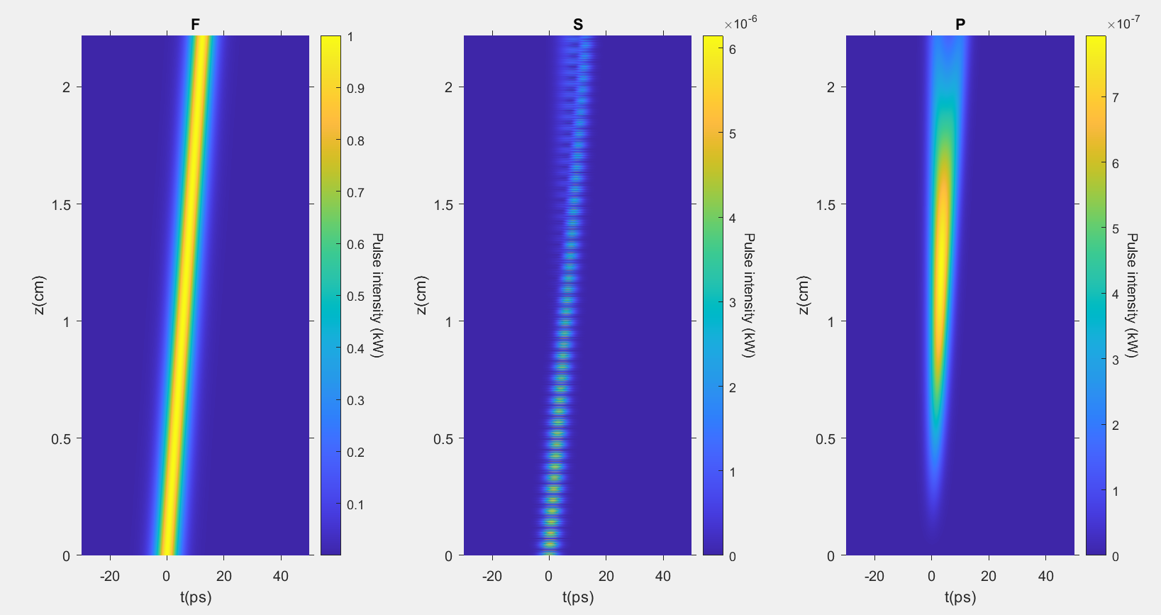

Slide 27
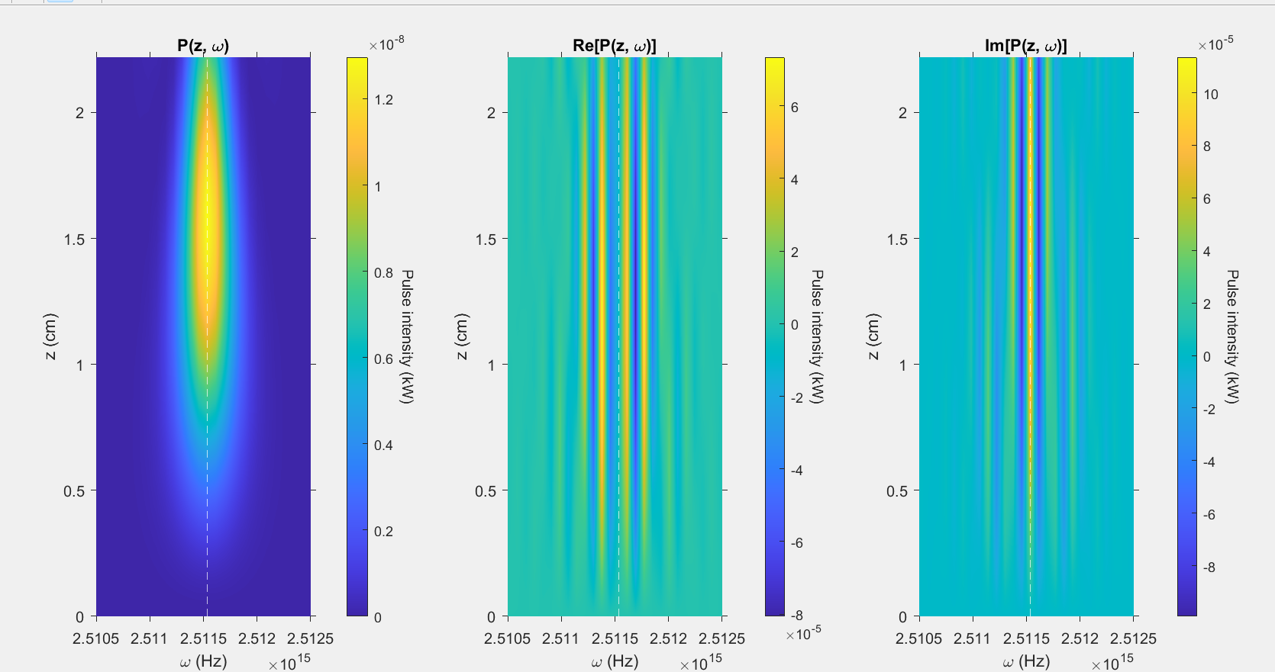

Slide 28
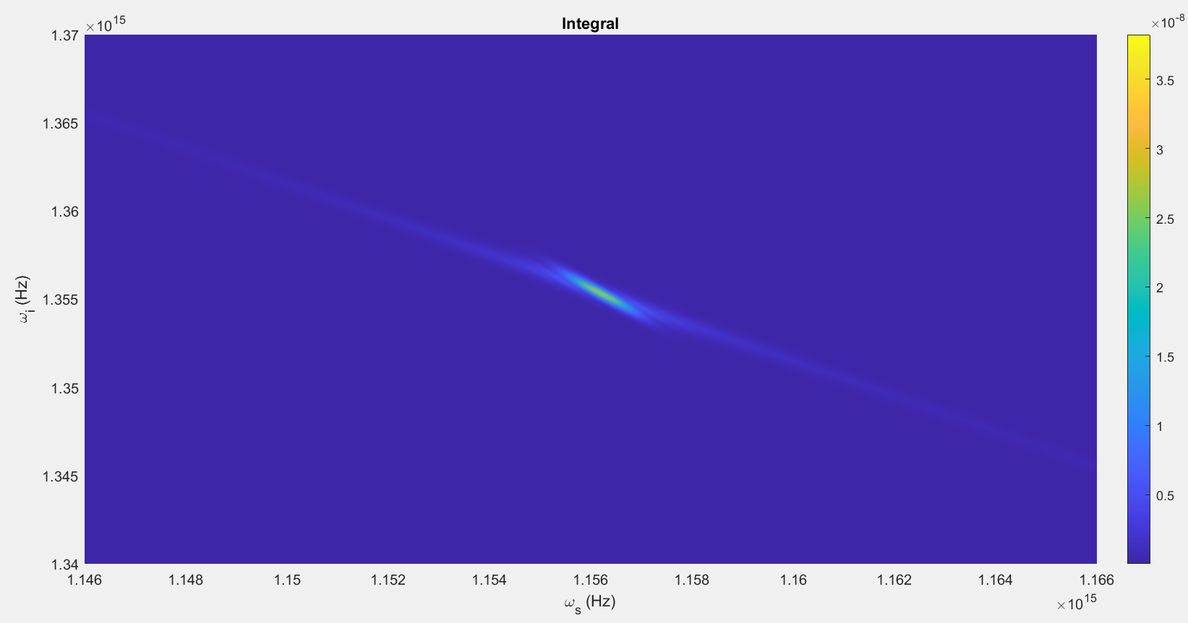

Slide 29
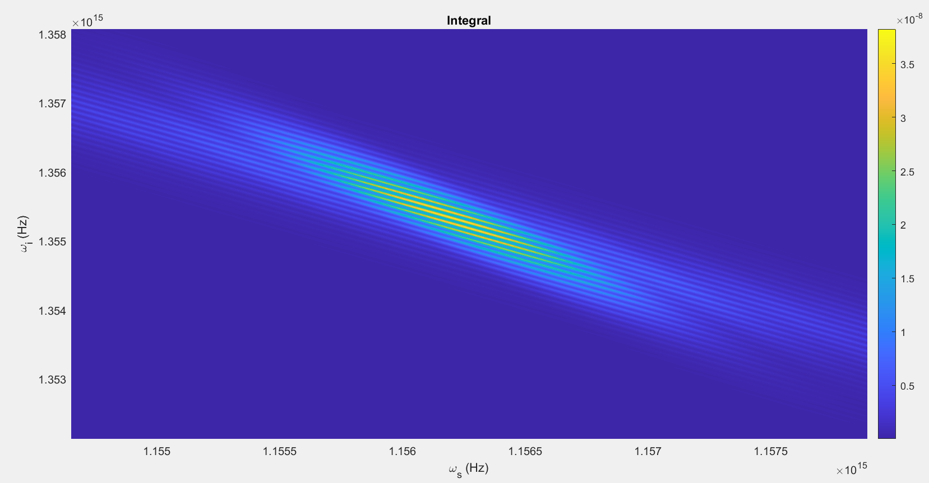

Slide 30
Changes
No/Unnoticeable changes anywhere

Slide 31
Parameters #6:
T = 80ps
N=2048
Beta_f2 = 0.0083 ps^2/cm
Beta_s2 = 0.0022 ps^2/cm
Beta_p2 = 0.0253 ps^2/cm
Beta_f1 = 5.633 ps/cm
Beta_s1 = 5.333 ps/cm
Kappa = 3450, 1/cm
Gamma = 10^1.5, 1/(cm sqrt(kW))
C = 1, 1/cm
A = 1kW
Pulsewidth = 10ps
U0 = Real

Slide 32
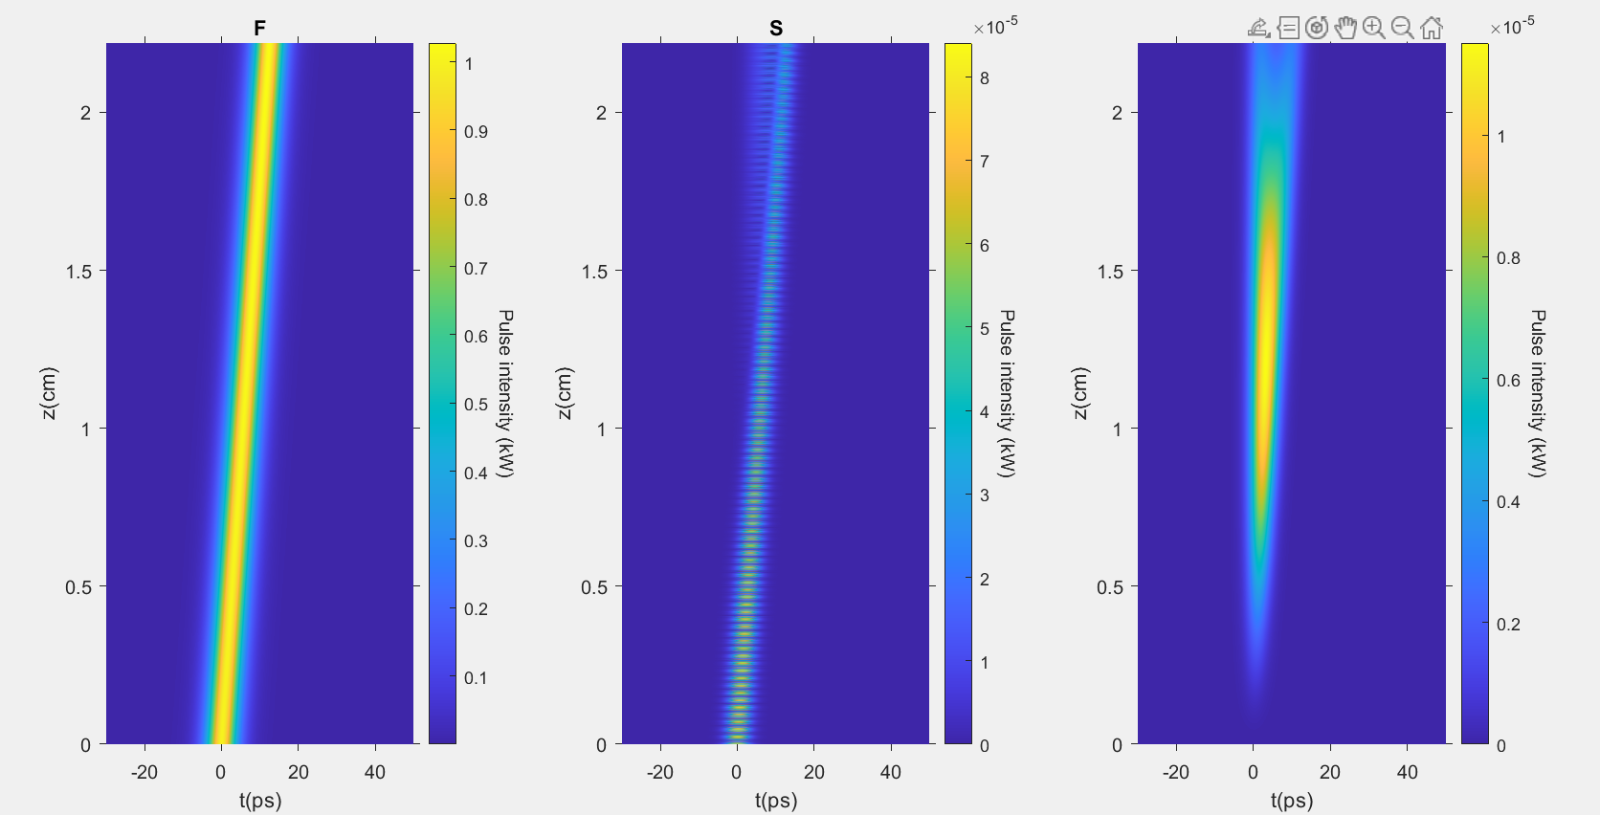

Slide 33
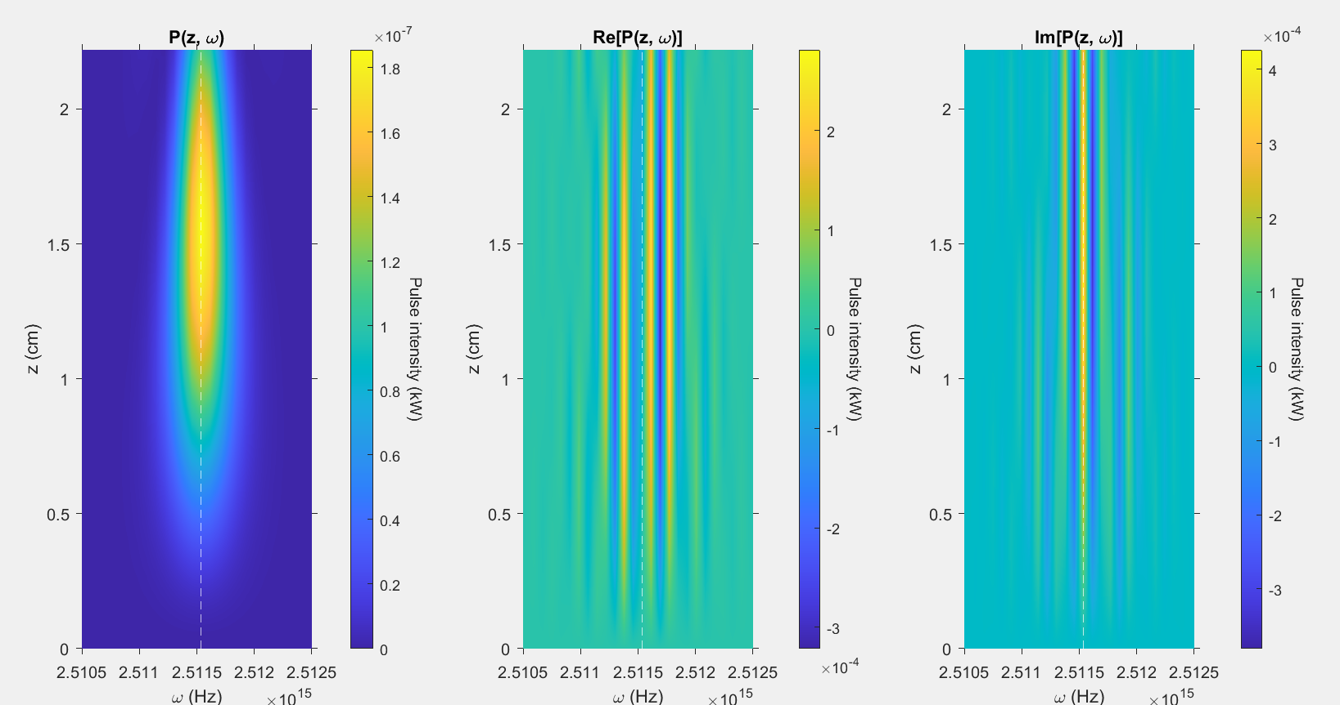

Slide 34
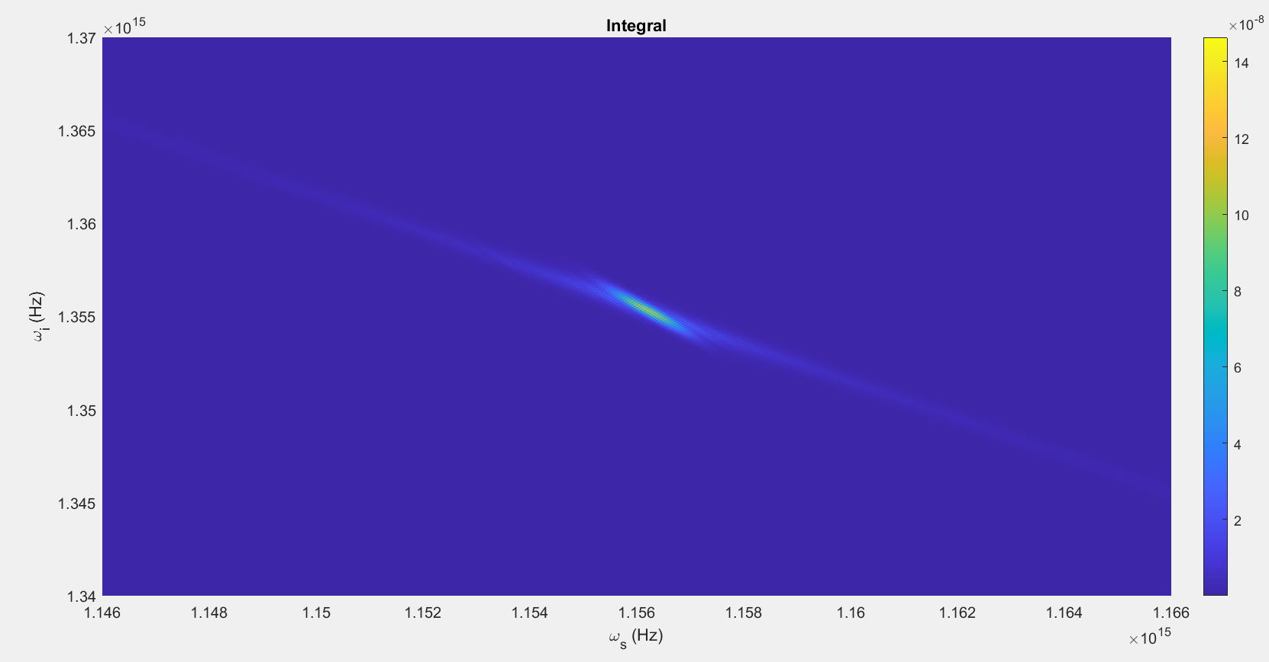

Slide 35
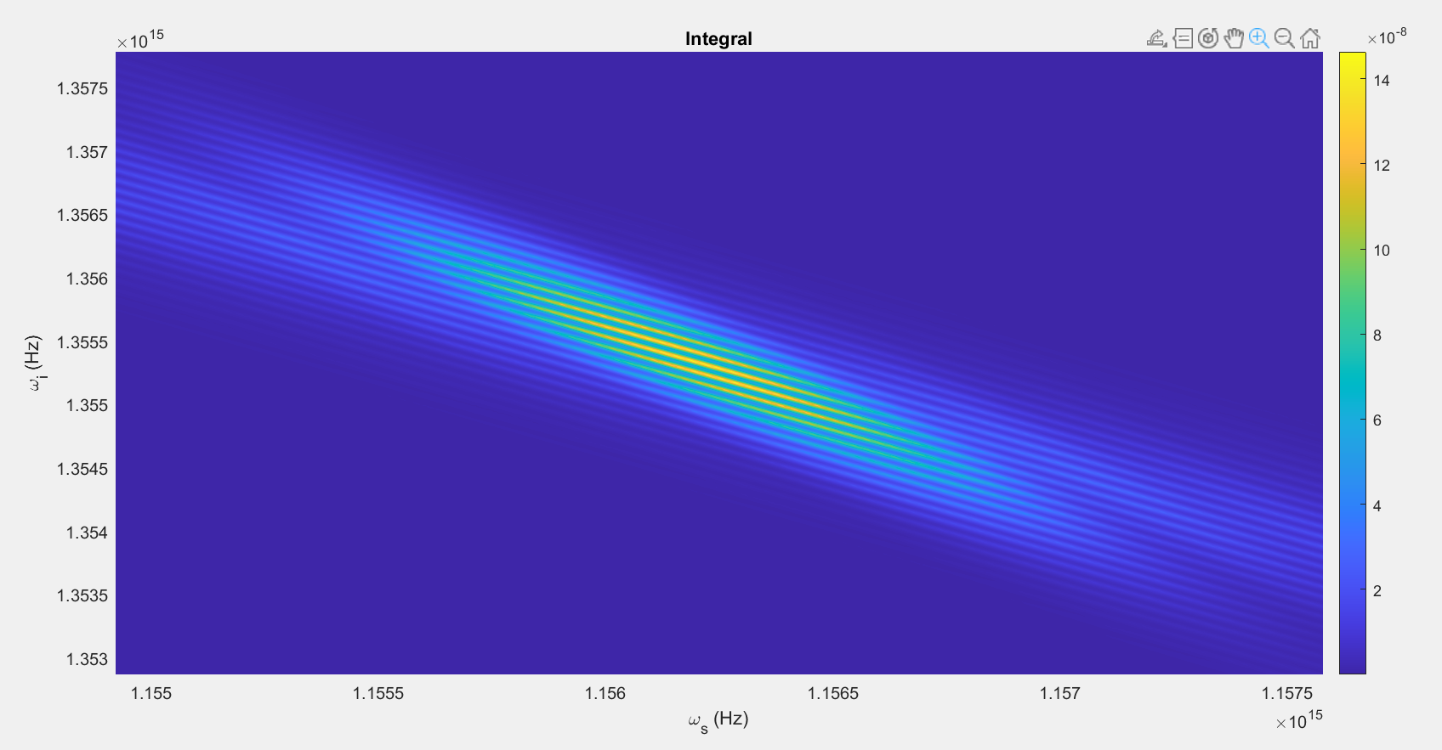

Slide 36
Changes
No/Unnoticeable changes anywhere

Slide 37
Parameters #7:
T = 80ps
N=2048
Beta_f2 = 0.0083 ps^2/cm
Beta_s2 = 0.0022 ps^2/cm
Beta_p2 = 0.0253 ps^2/cm
Beta_f1 = 5.633 ps/cm
Beta_s1 = 5.333 ps/cm
Kappa = 6900, 1/cm
Gamma = 2*10^1.5, 1/(cm sqrt(kW))
C = 1, 1/cm
A = 1kW
Pulsewidth = 10ps
U0 = Real

Slide 38
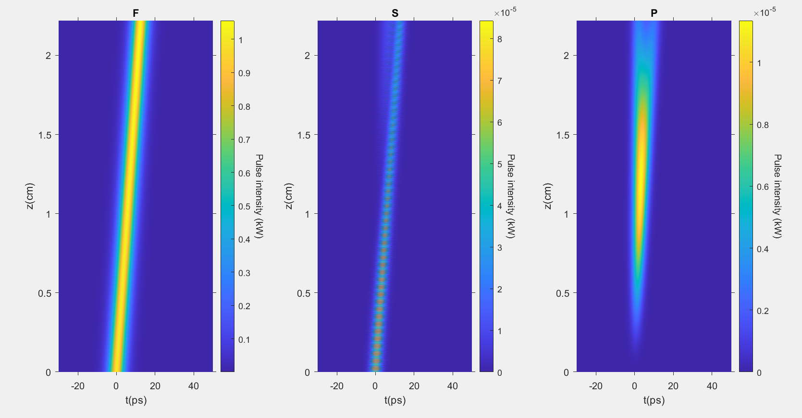

Slide 39
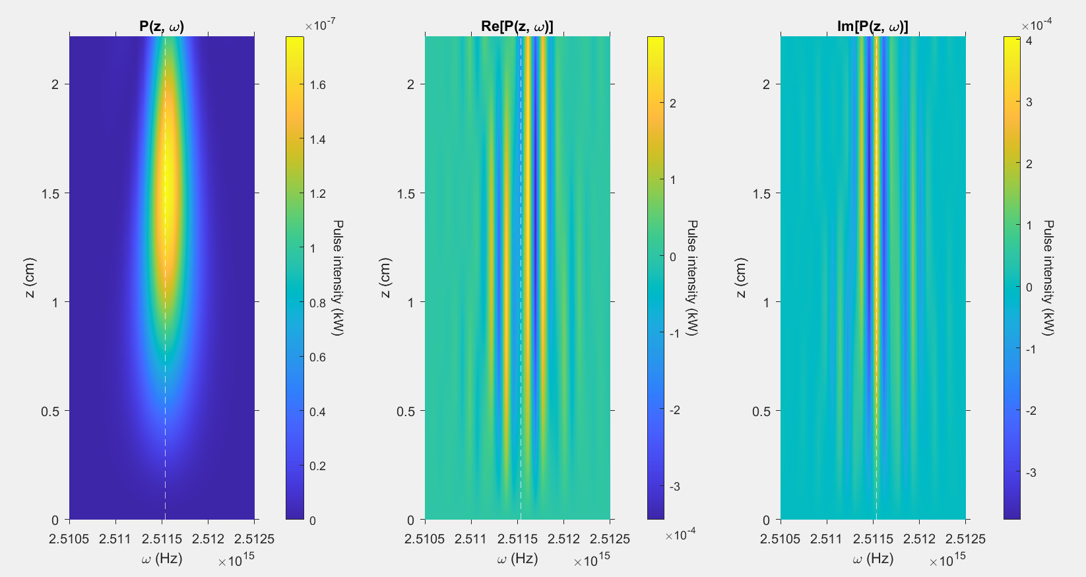

Slide 40
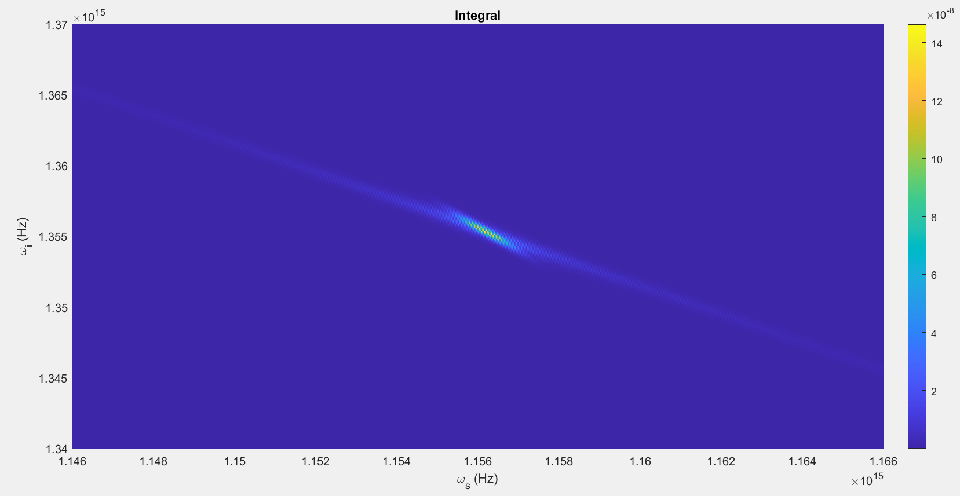

Slide 41
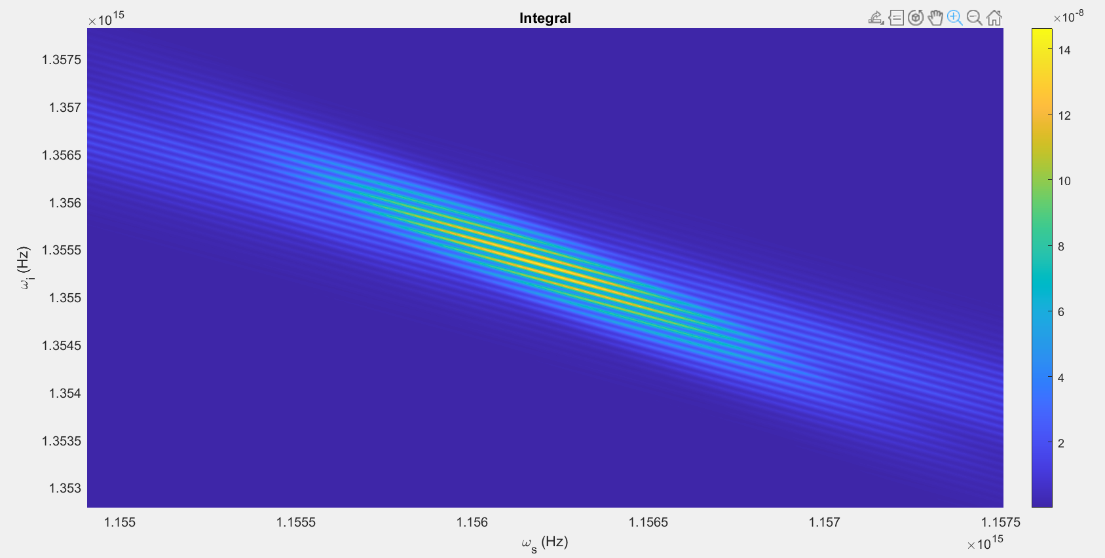

Slide 42
Changes
No/Unnoticeable changes anywhere

Slide 43
Parameters #8:
T = 80ps
N=2048
Beta_f2 = 0.0083 ps^2/cm
Beta_s2 = 0.0022 ps^2/cm
Beta_p2 = 0.0253 ps^2/cm
Beta_f1 = 5.633 ps/cm
Beta_s1 = 5.333 ps/cm
Kappa = 6900, 1/cm
Gamma = 0.5*10^1.5, 1/(cm sqrt(kW))
C = 1, 1/cm
A = 1kW
Pulsewidth = 10ps
U0 = Real

Slide 44
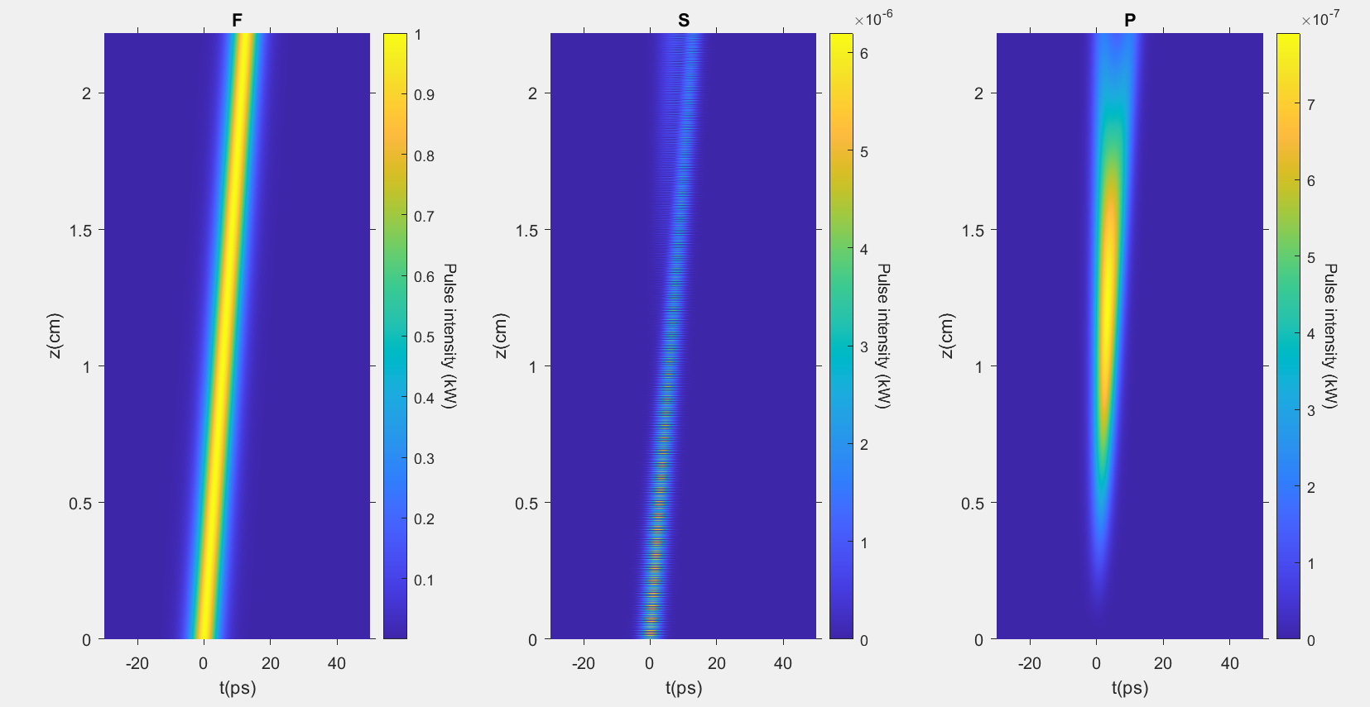

Slide 45
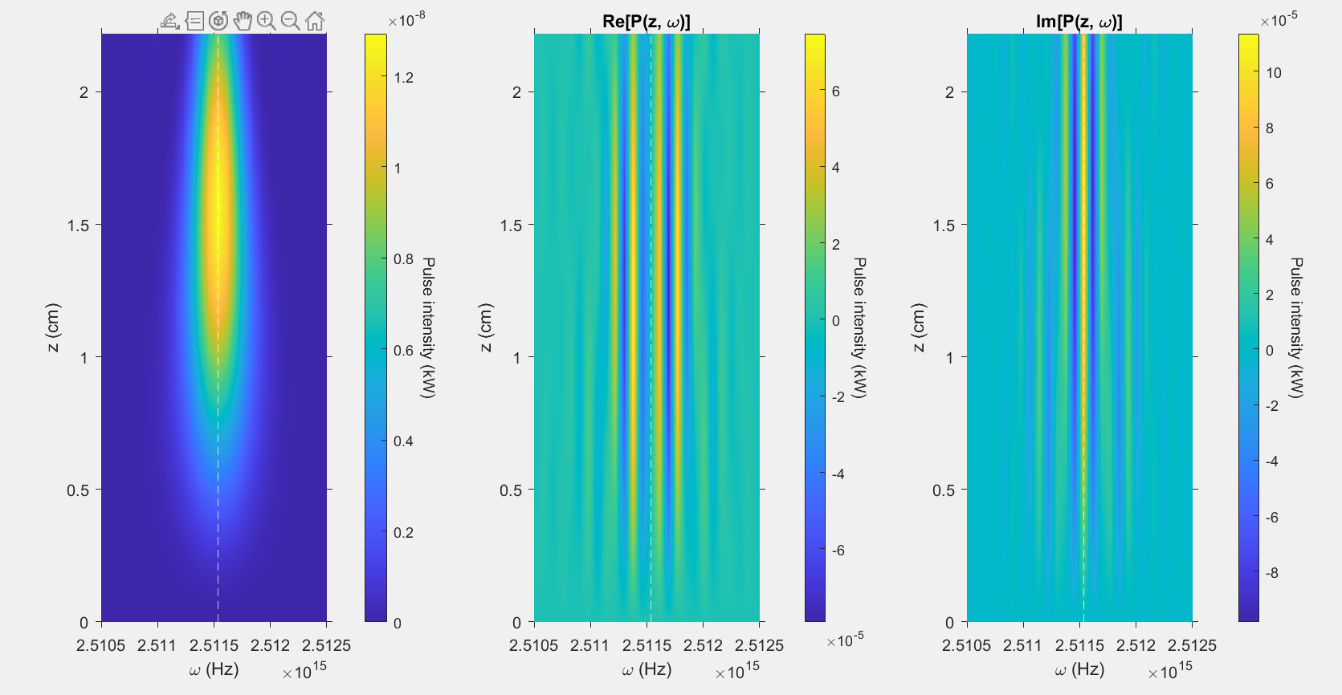

Slide 46
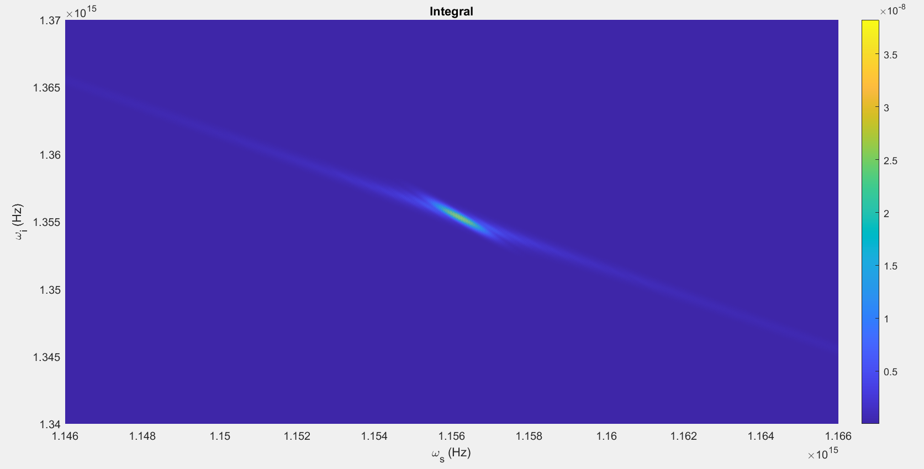

Slide 47
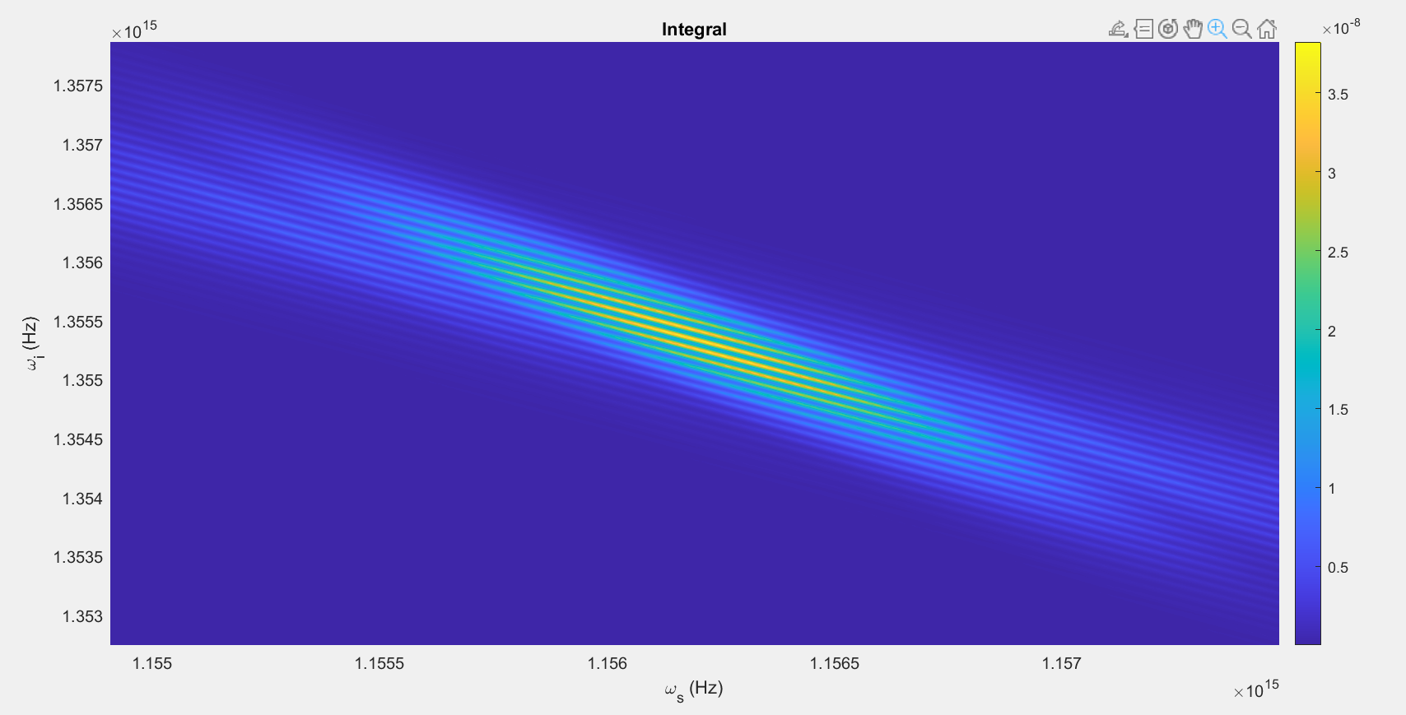

Slide 48
Changes
No/Unnoticeable changes anywhere

Slide 49
Parameters #9:
T = 80ps
N=2048
Beta_f2 = 0.0083 ps^2/cm
Beta_s2 = 0.0022 ps^2/cm
Beta_p2 = 0.0253 ps^2/cm
Beta_f1 = 5.633 ps/cm
Beta_s1 = 5.333 ps/cm
Kappa = 6900, 1/cm
Gamma = 10^1.5, 1/(cm sqrt(kW))
C = 1, 1/cm
A = 2kW
Pulsewidth = 10ps
U0 = Real

Slide 50
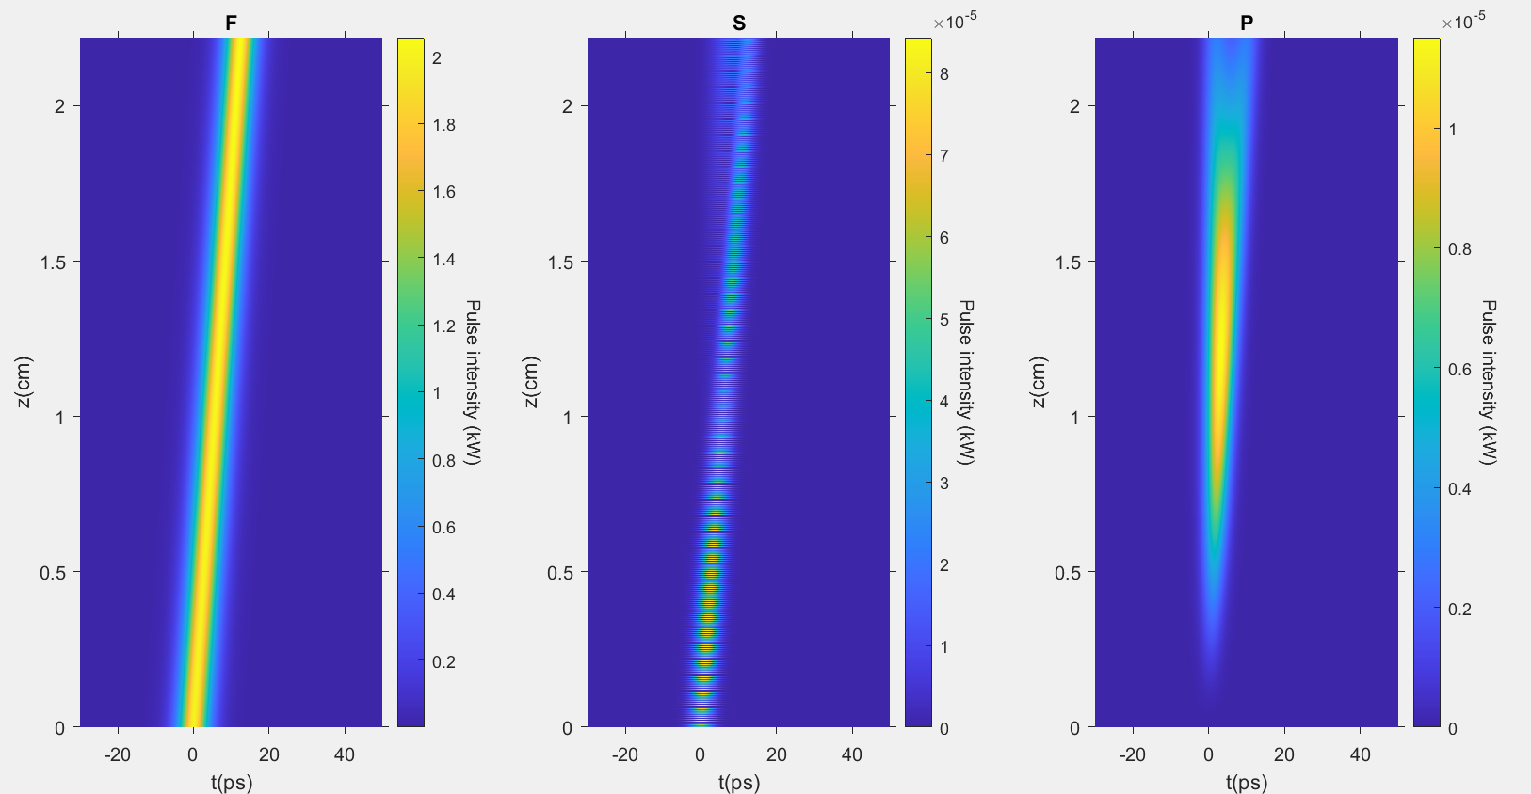

Slide 51
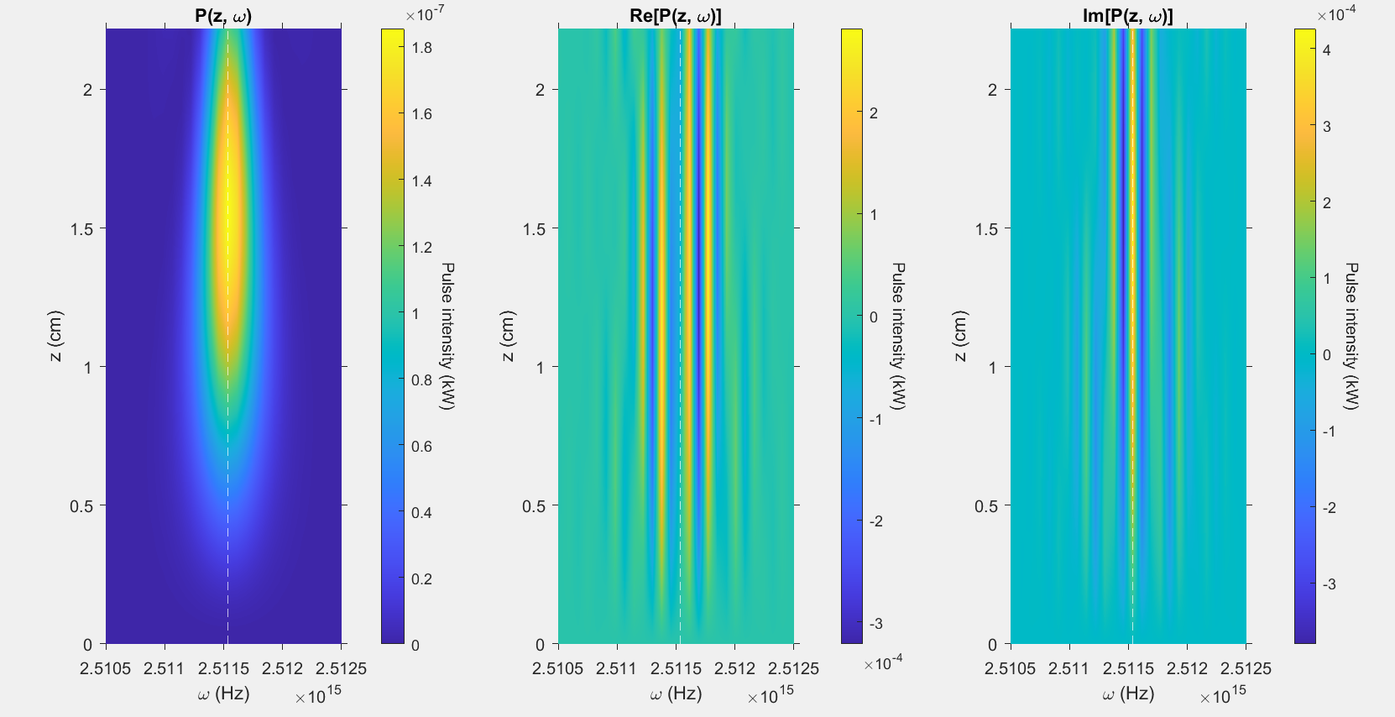

Slide 52
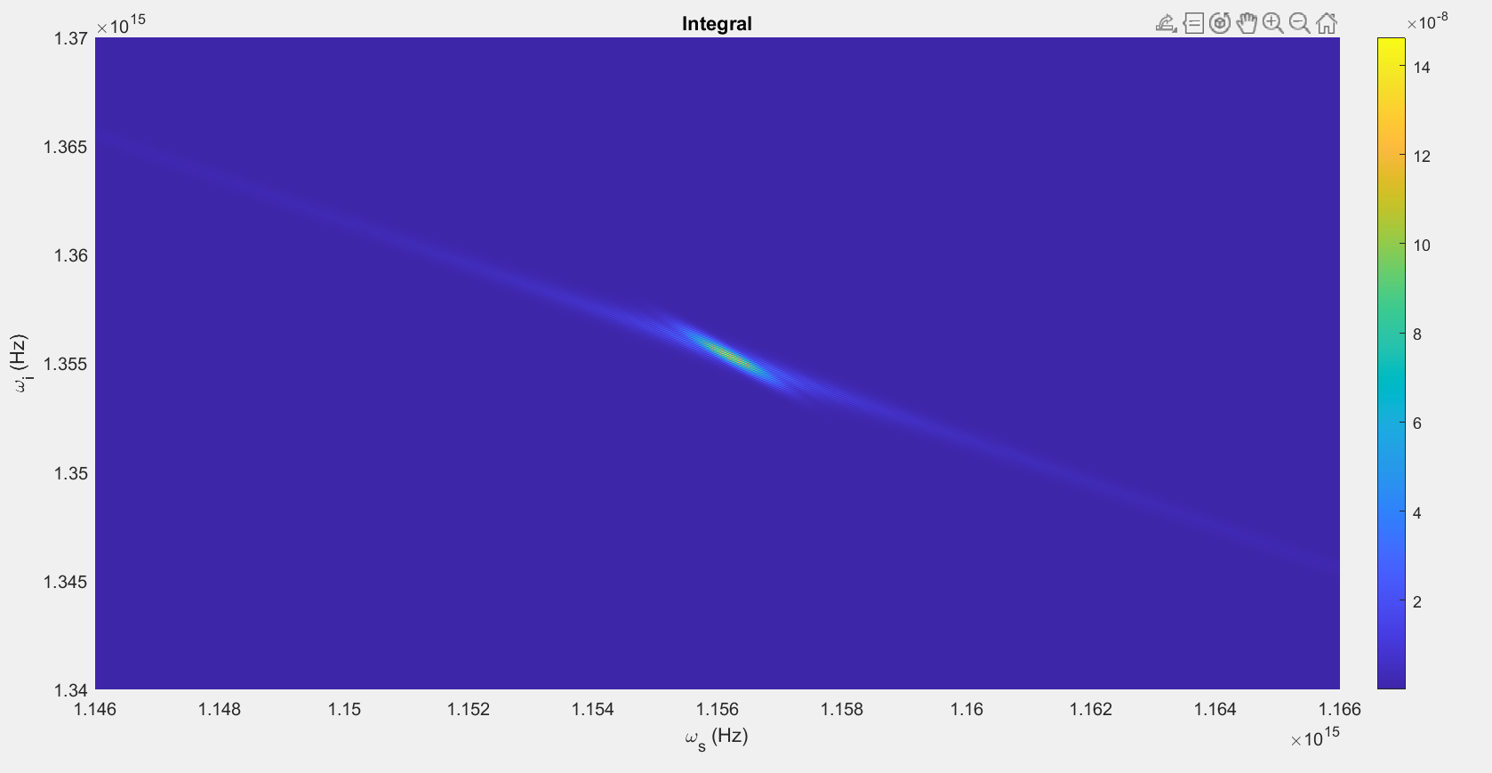

Slide 53
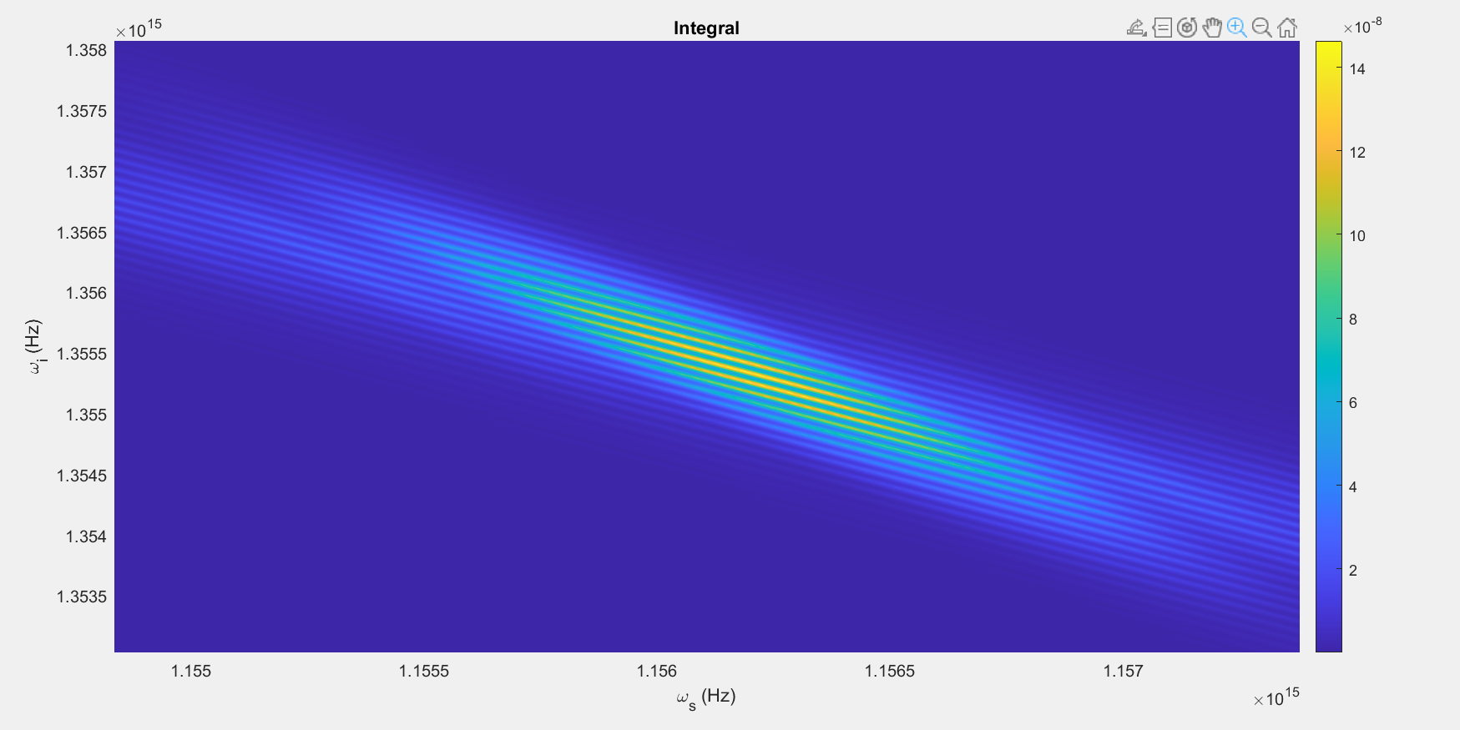

Slide 54
Changes
No/Unnoticeable changes anywhere

Slide 55
Parameters #10:
T = 80ps
N=2048
Beta_f2 = 0.0083 ps^2/cm
Beta_s2 = 0.0022 ps^2/cm
Beta_p2 = 0.0253 ps^2/cm
Beta_f1 = 5.633 ps/cm
Beta_s1 = 5.333 ps/cm
Kappa = 6900, 1/cm
Gamma = 10^1.5, 1/(cm sqrt(kW))
C = 1, 1/cm
A = 0.5kW
Pulsewidth = 10ps
U0 = Real

Slide 56
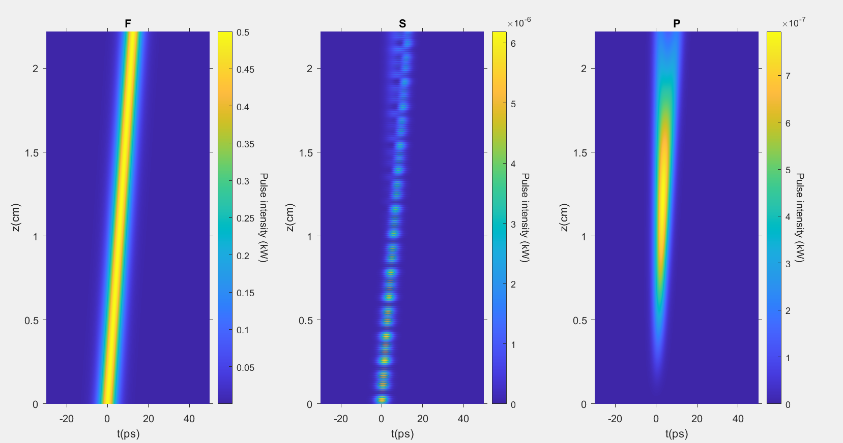

Slide 57
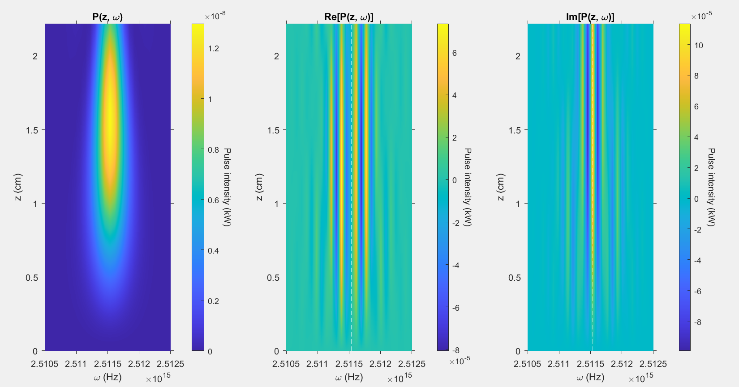

Slide 58
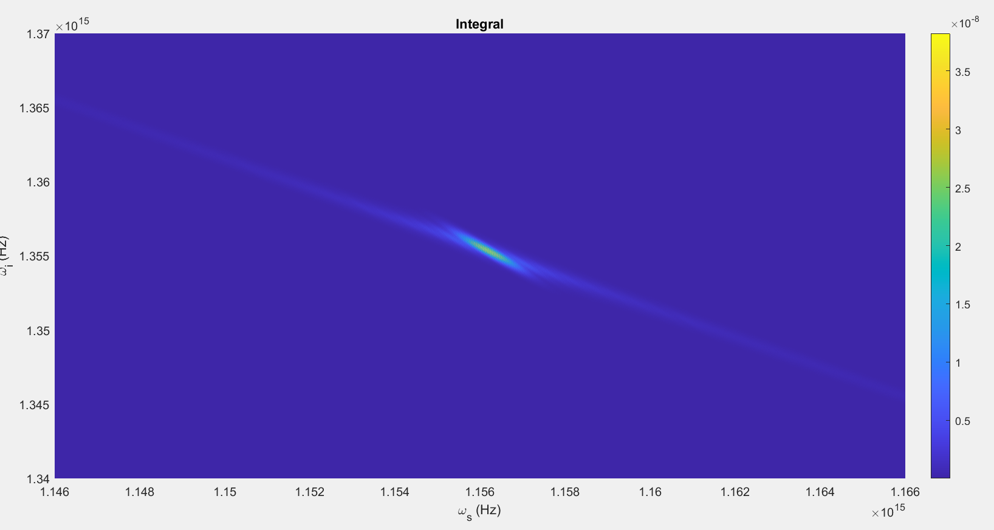

Slide 59
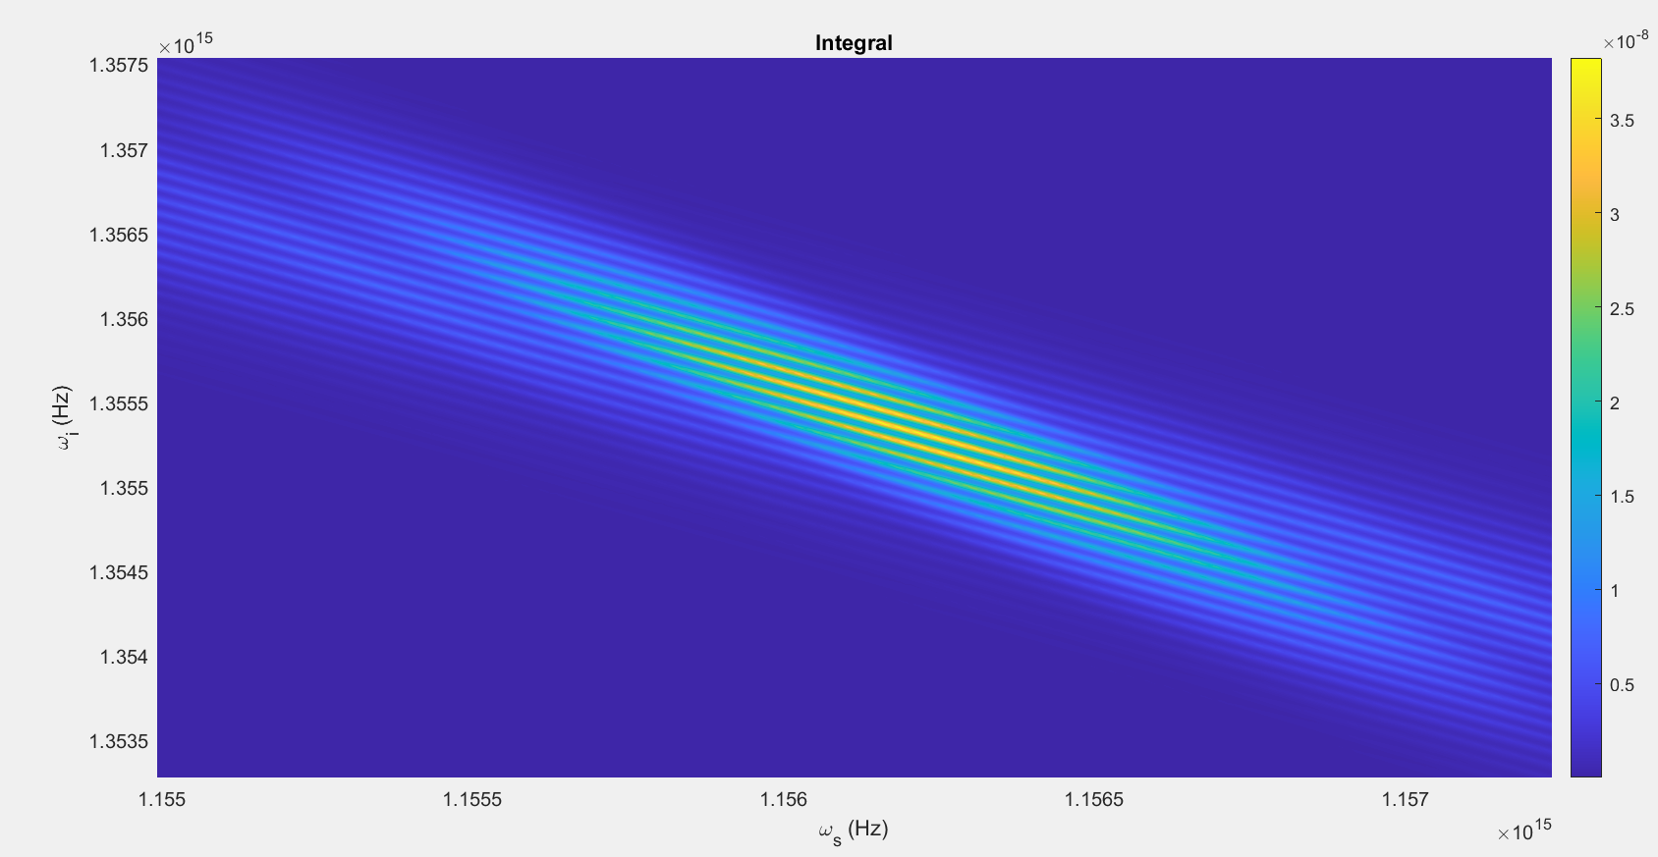

Slide 60
Changes
No/Unnoticeable changes anywhere

Slide 61
Parameters #11:
T = 80ps
N=2048
Beta_f2 = 0.0083 ps^2/cm
Beta_s2 = 0.0022 ps^2/cm
Beta_p2 = 0.0253 ps^2/cm
Beta_f1 = 5.633 ps/cm
Beta_s1 = 5.333 ps/cm
Kappa = 6900, 1/cm
Gamma = 10^1.5, 1/(cm sqrt(kW))
C = 1, 1/cm
A = 1kW
Pulsewidth = 20ps
U0 = Real

Slide 62
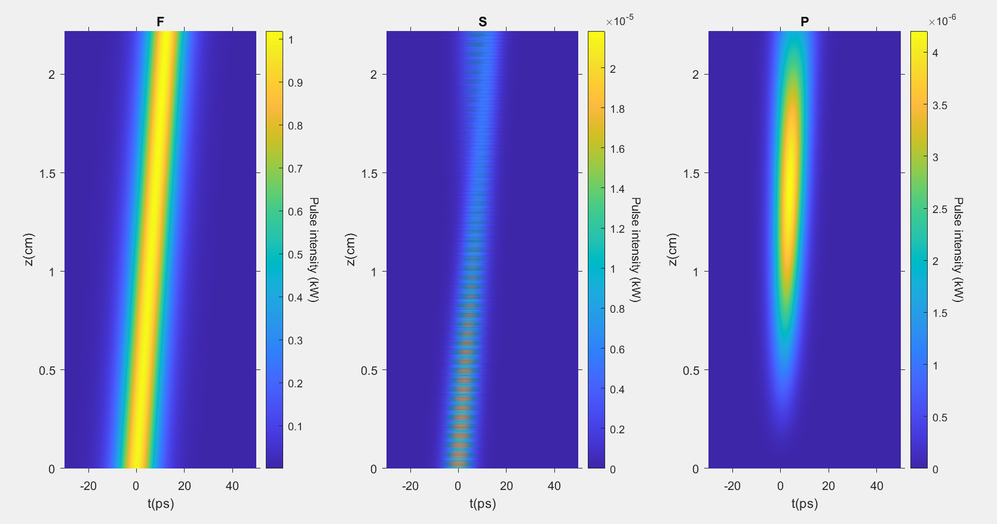

Slide 63
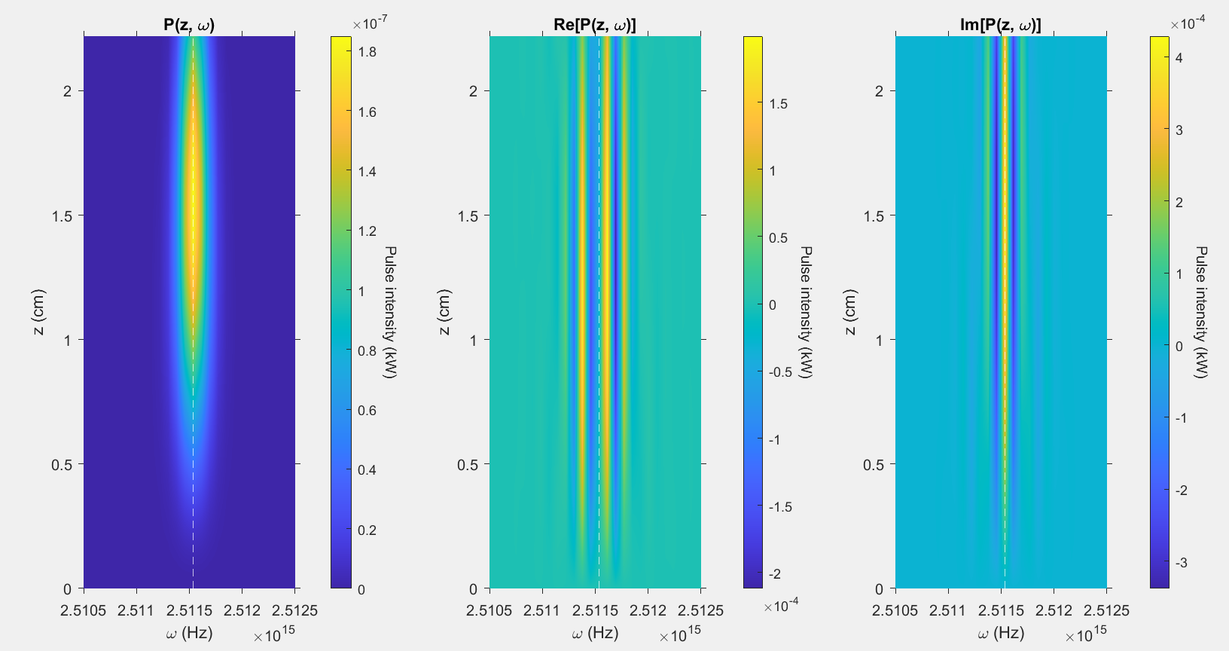

Slide 64
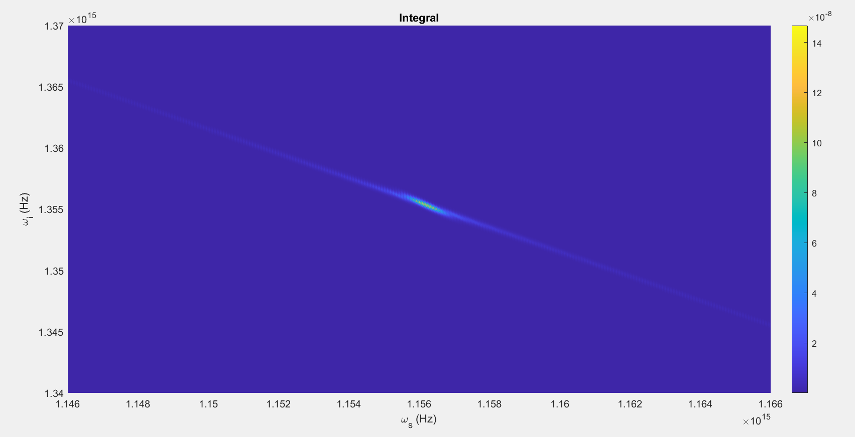

Slide 65
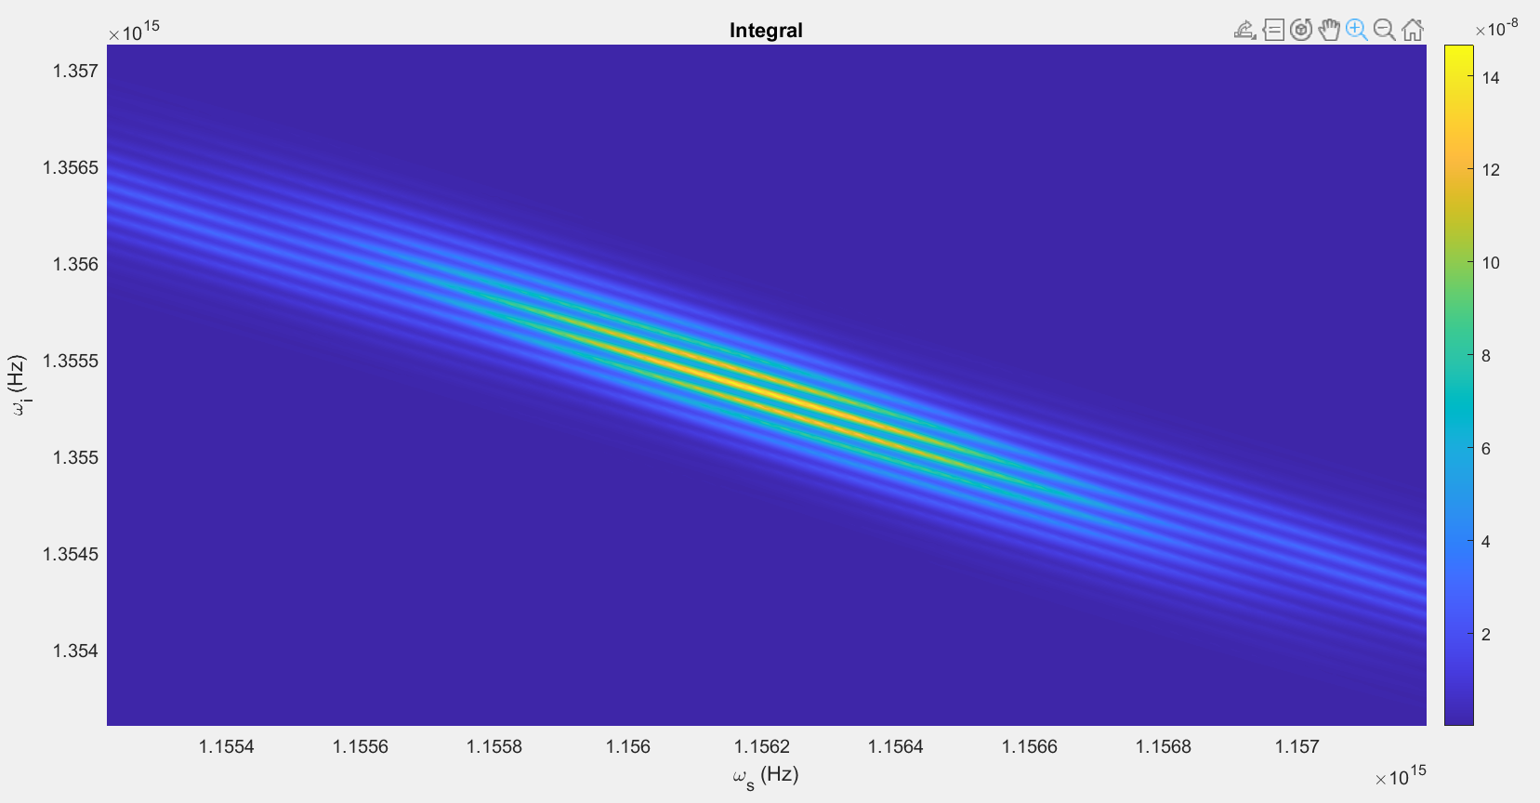

Slide 66
Changes
Split of pulse in P(z,t), and therefore P(z,omega), less noticeable
Pulse in final integral plot no longer at weird angle compared to shadow

Slide 67
Parameters #12:
T = 80ps
N=2048
Beta_f2 = 0.0083 ps^2/cm
Beta_s2 = 0.0022 ps^2/cm
Beta_p2 = 0.0253 ps^2/cm
Beta_f1 = 5.633 ps/cm
Beta_s1 = 5.333 ps/cm
Kappa = 6900, 1/cm
Gamma = 10^1.5, 1/(cm sqrt(kW))
C = 1, 1/cm
A = 1kW
Pulsewidth = 5ps
U0 = Real

Slide 68
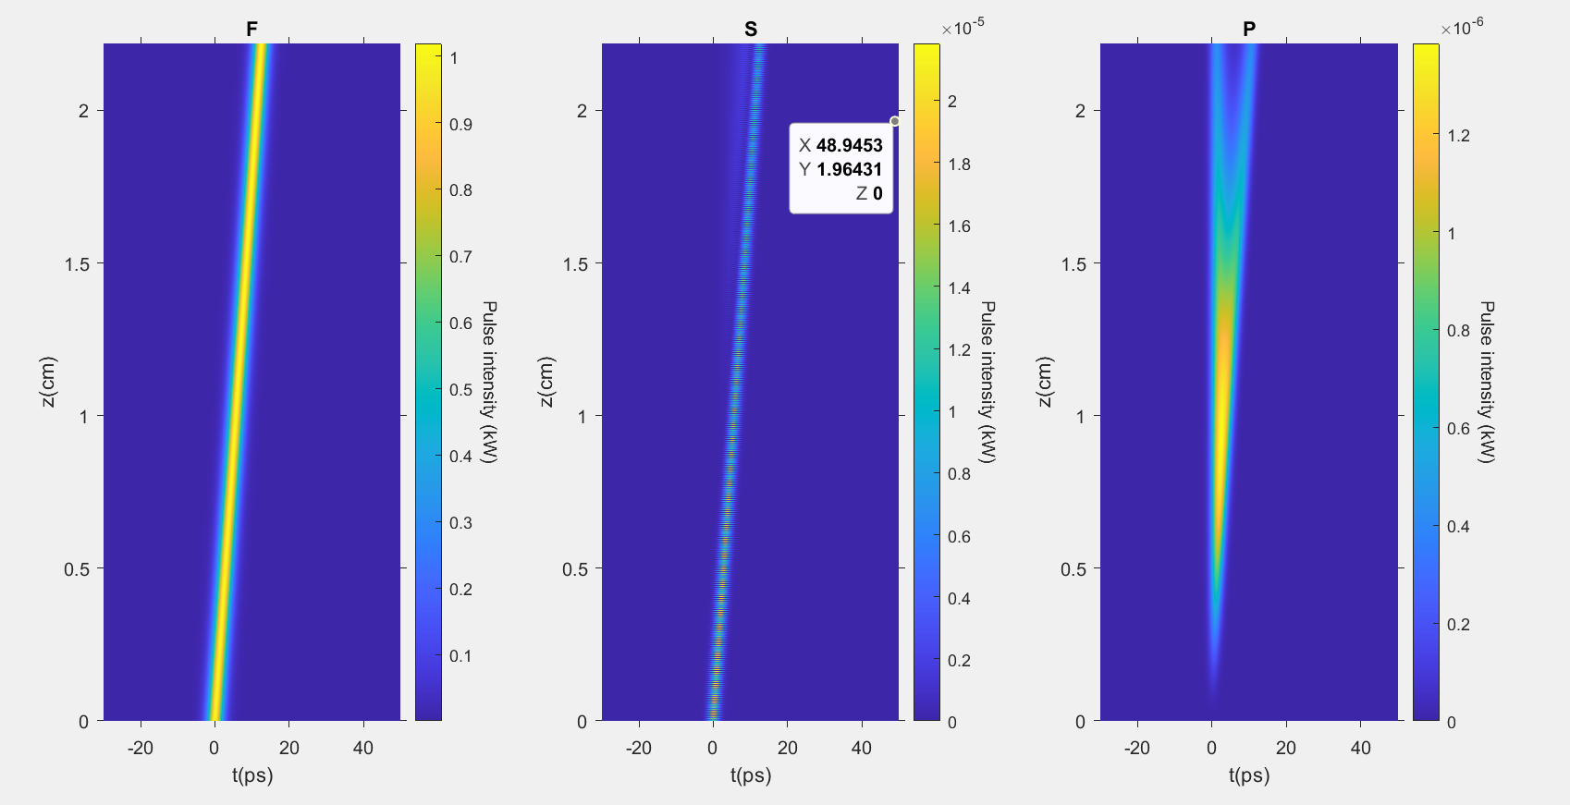

Slide 69
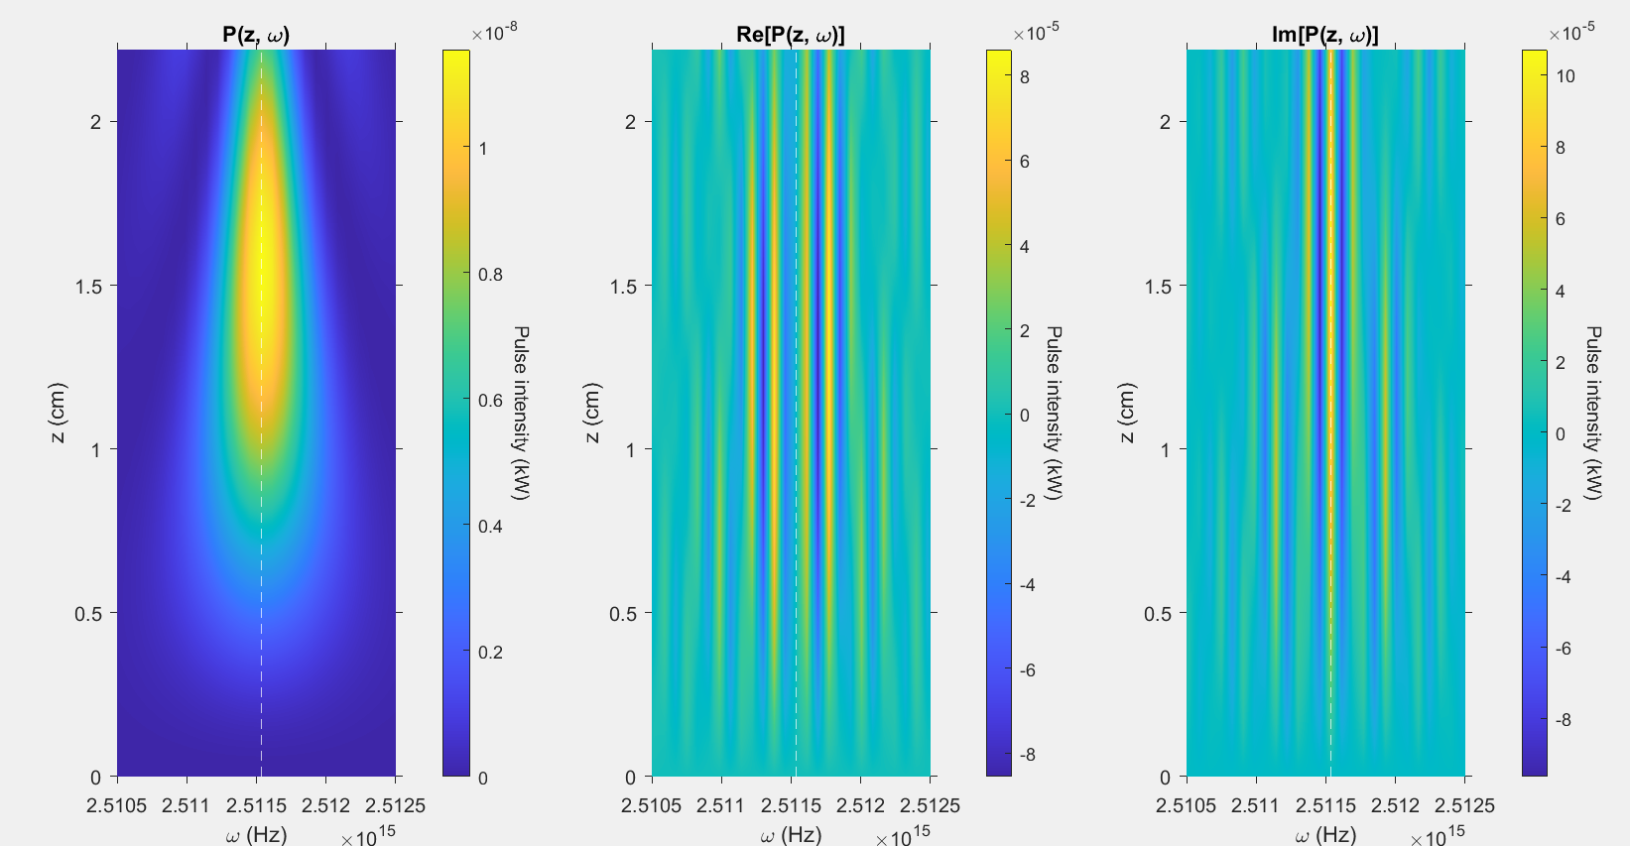

Slide 70
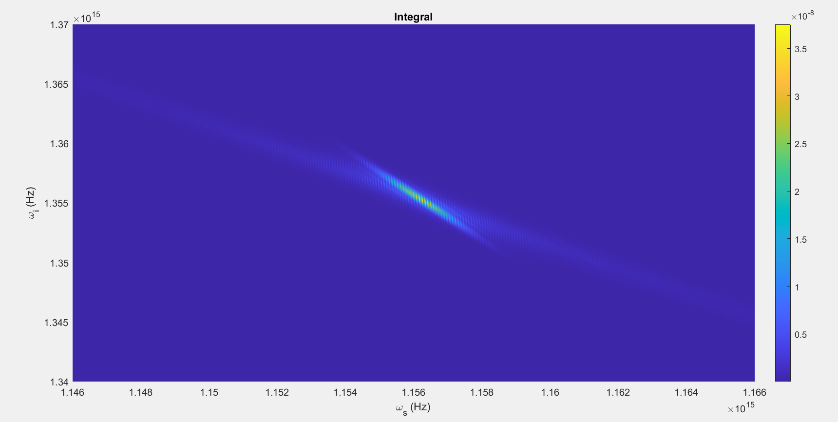

Slide 71
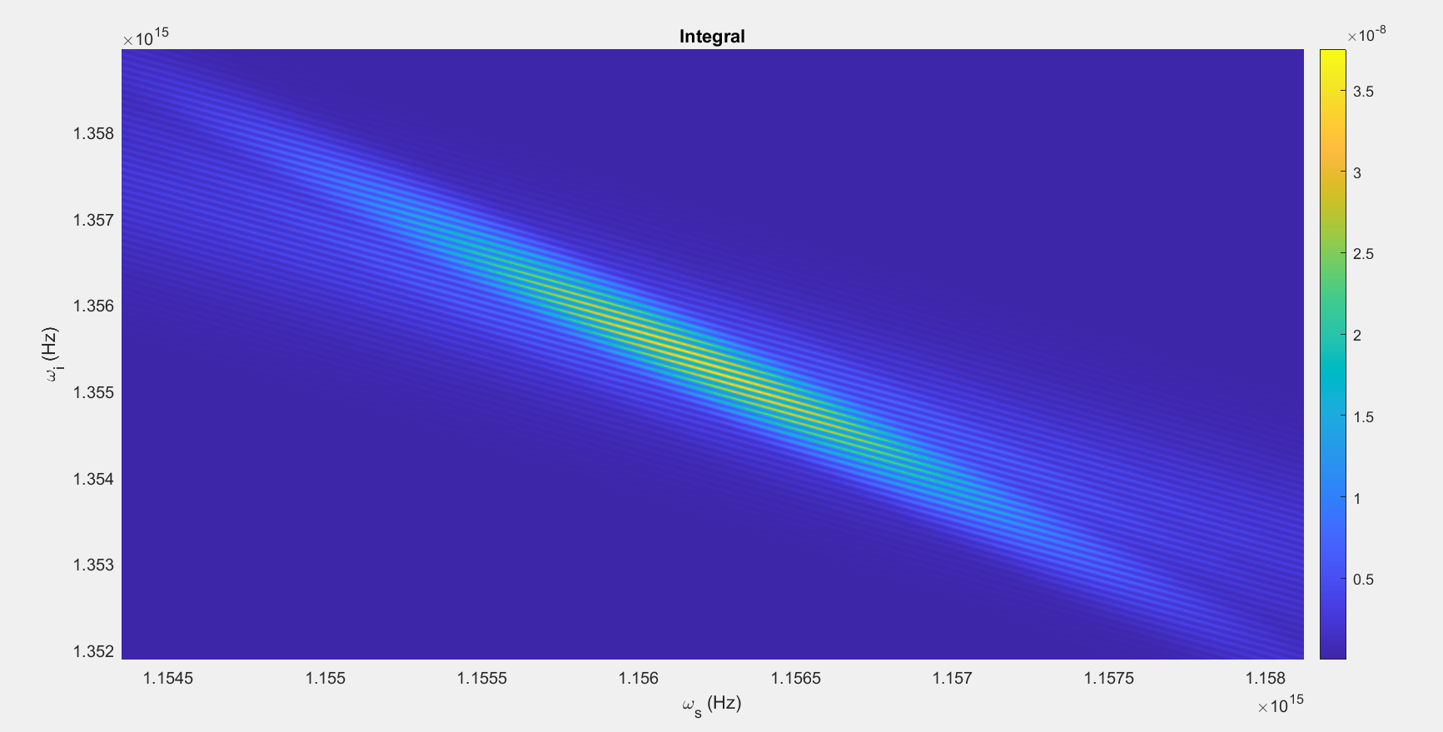

Slide 72
Changes
Splitting of pulse in P(z,t) and P(z,omega) more noticeable

Slide 73
Parameters #13:
T = 160ps, Zmax halved to compensate
N=2048
Beta_f2 = 0.0083 ps^2/cm
Beta_s2 = 0.0022 ps^2/cm
Beta_p2 = 0.0253 ps^2/cm
Beta_f1 = 5.633 ps/cm
Beta_s1 = 5.333 ps/cm
Kappa = 6900, 1/cm
Gamma = 10^1.5, 1/(cm sqrt(kW))
C = 1, 1/cm
A = 1kW
Pulsewidth = 10ps
U0 = Real

Slide 74
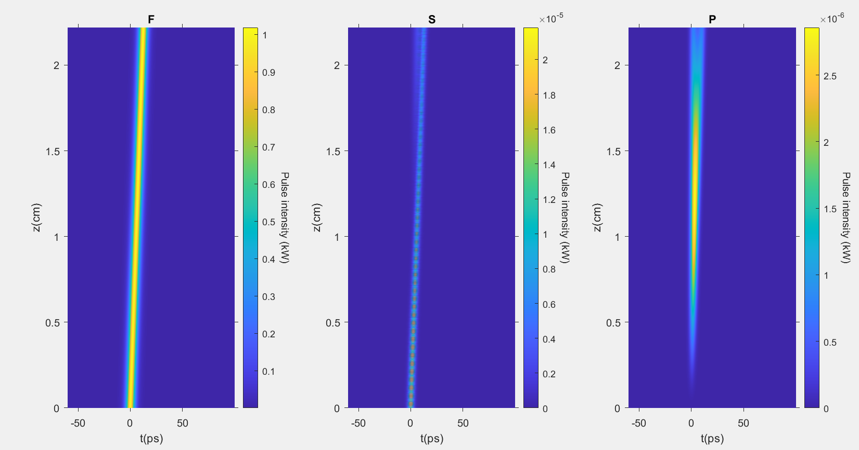

Slide 75


Slide 76


Slide 77


Slide 78
Parameters #14:
T = 40ps, Zmax doubled to compensate
N=2048
Beta_f2 = 0.0083 ps^2/cm
Beta_s2 = 0.0022 ps^2/cm
Beta_p2 = 0.0253 ps^2/cm
Beta_f1 = 5.633 ps/cm
Beta_s1 = 5.333 ps/cm
Kappa = 6900, 1/cm
Gamma = 10^1.5, 1/(cm sqrt(kW))
C = 1, 1/cm
A = 1kW
Pulsewidth = 10ps
U0 = Real

Slide 79


Slide 80


Slide 81


Slide 82


Slide 83
Parameters #15:
T = 80ps
N=1024
Beta_f2 = 0.0083 ps^2/cm
Beta_s2 = 0.0022 ps^2/cm
Beta_p2 = 0.0253 ps^2/cm
Beta_f1 = 5.633 ps/cm
Beta_s1 = 5.333 ps/cm
Kappa = 6900, 1/cm
Gamma = 10^1.5, 1/(cm sqrt(kW))
C = 1, 1/cm
A = 1kW
Pulsewidth = 10ps
U0 = Real

Slide 84


Slide 85


Slide 86


Slide 87


Slide 88
Parameters #16:
T = 40ps, Zmax doubled to compensate
N=1024
Beta_f2 = 0.0083 ps^2/cm
Beta_s2 = 0.0022 ps^2/cm
Beta_p2 = 0.0253 ps^2/cm
Beta_f1 = 5.633 ps/cm
Beta_s1 = 5.333 ps/cm
Kappa = 6900, 1/cm
Gamma = 10^1.5, 1/(cm sqrt(kW))
C = 1, 1/cm
A = 1kW
Pulsewidth = 10ps
U0 = Real

Slide 89


Slide 90


Slide 91


Slide 92


Slide 93
Parameters#17:
T = 80ps,
N=2048
Beta_f2 = 0 ps^2/cm
Beta_s2 = 0 ps^2/cm
Beta_p2 = 0 ps^2/cm
Beta_f1 = 5.633 ps/cm
Beta_s1 = 5.333 ps/cm
Kappa = 6900, 1/cm
Gamma = 10^1.5, 1/(cm sqrt(kW))
C = 1, 1/cm
A = 1kW
Pulsewidth = 10ps
U0 = Real

Slide 94


Slide 95


Slide 96


Slide 97


Slide 98
Parameters #18:
T = 80ps
N=2048
Beta_f2 = 0.0083 ps^2/cm
Beta_s2 = 0.0022 ps^2/cm
Beta_p2 = 0.0253 ps^2/cm
Beta_f1 = 0 ps/cm
Beta_s1 = 0 ps/cm
Kappa = 6900, 1/cm
Gamma = 10^1.5, 1/(cm sqrt(kW))
C = 1, 1/cm
A = 1kW
Pulsewidth = 10ps
U0 = Real

Slide 99


Slide 100


Slide 101


Slide 102


Slide 103
Parameters #19:
T = 80ps
N=2048
Beta_f2 = 0 ps^2/cm
Beta_s2 = 0 ps^2/cm
Beta_p2 = 0 ps^2/cm
Beta_f1 = 0 ps/cm
Beta_s1 = 0 ps/cm
Kappa = 6900, 1/cm
Gamma = 10^1.5, 1/(cm sqrt(kW))
C = 1, 1/cm
A = 1kW
Pulsewidth = 10ps
U0 = Real

Slide 104


Slide 105


Slide 106


Slide 107


Slide 108
Parameters 20
T = 1000; %320; % time domain width
N = 2048; % N discretization points
dt = T/N;
t = [-T/2 : dt : T/2 - dt]'; % time domain in ps (ps determined by constants)
delta = (2 * pi / T) * [-N/2 : 1 : N/2 - 1]'; %Inverse time domain
delta = fftshift(delta);
% Constants
Beta_f2 = 0.83e-2; %Units in ps^2/cm
Beta_s2 = 0.22e-2; %Units in ps^2/cm
Beta_p2 = 2.53e-2; %Units in ps^2/cm
Beta_f1 = 563.3e-2; %Units in ps/cm
Beta_s1 = 533.3e-2; %Units in ps/cm
kappa = 6.9e3; %Units in 1/cm
gamma = 10^1.5; %Units in 1/(cm*sqrt(kW))
C = 1; %Units in 1/cm, C=2 corresponds to a rail seperation of x=200nm

Slide 109


T = 320

Slide 110


T = 1000

Slide 111


T = 3200

